Slide 1
Water Supply Update
Don Seymour, P.E.
Water Agency Principal Engineer
Donald.Seymour@scwa.ca.gov

Slide 2
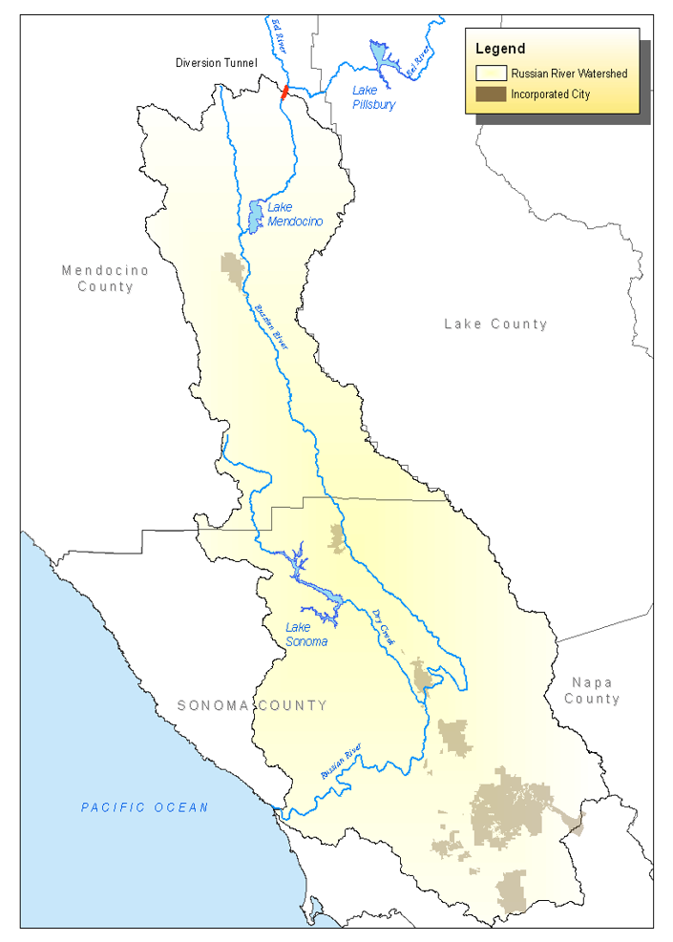
Russian River Reservoirs
Dual Purpose Facilities - Flood Protection (USACE) - Water Supply (Sonoma Water) - Operations Dictated by Storage Levels
Relative to “Rule Curve”
Lake Mendocino (Coyote Valley Dam) Flood Control Pool: 48,100 AF Water Supply Pool: Nov. – March 68,400 AF May – October 111,000 AF
Lake Sonoma (Warm Springs Dam) Flood Control Pool:136,000 AF Water Supply Pool: 245,000 AF
Lake Mendocino
Lake Sonoma

Slide 3
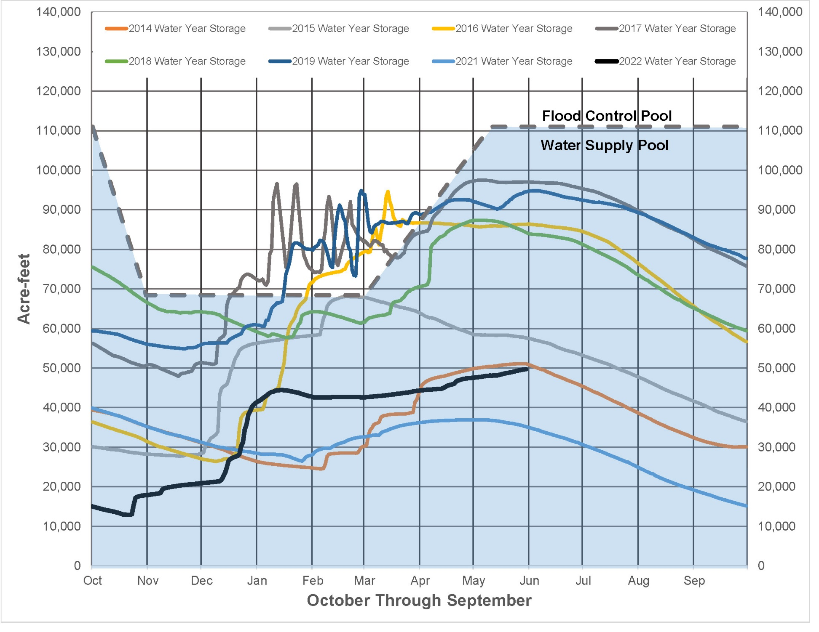
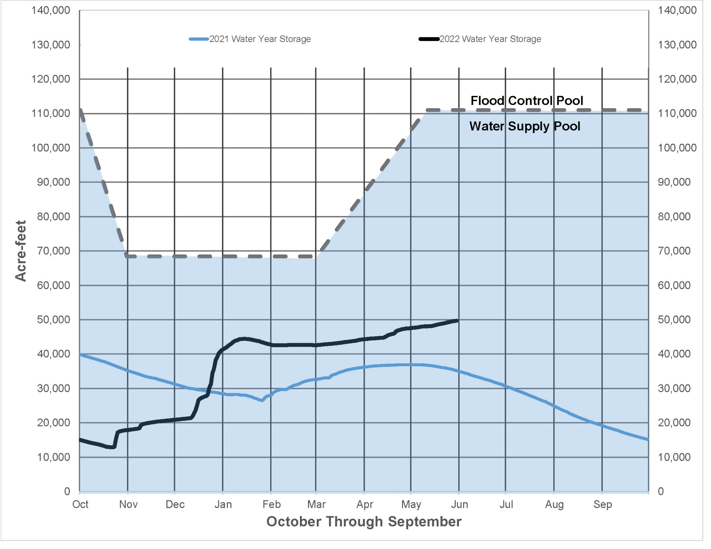
Lake Mendocino Storage

Slide 4
Lake Mendocino Storage

Slide 5
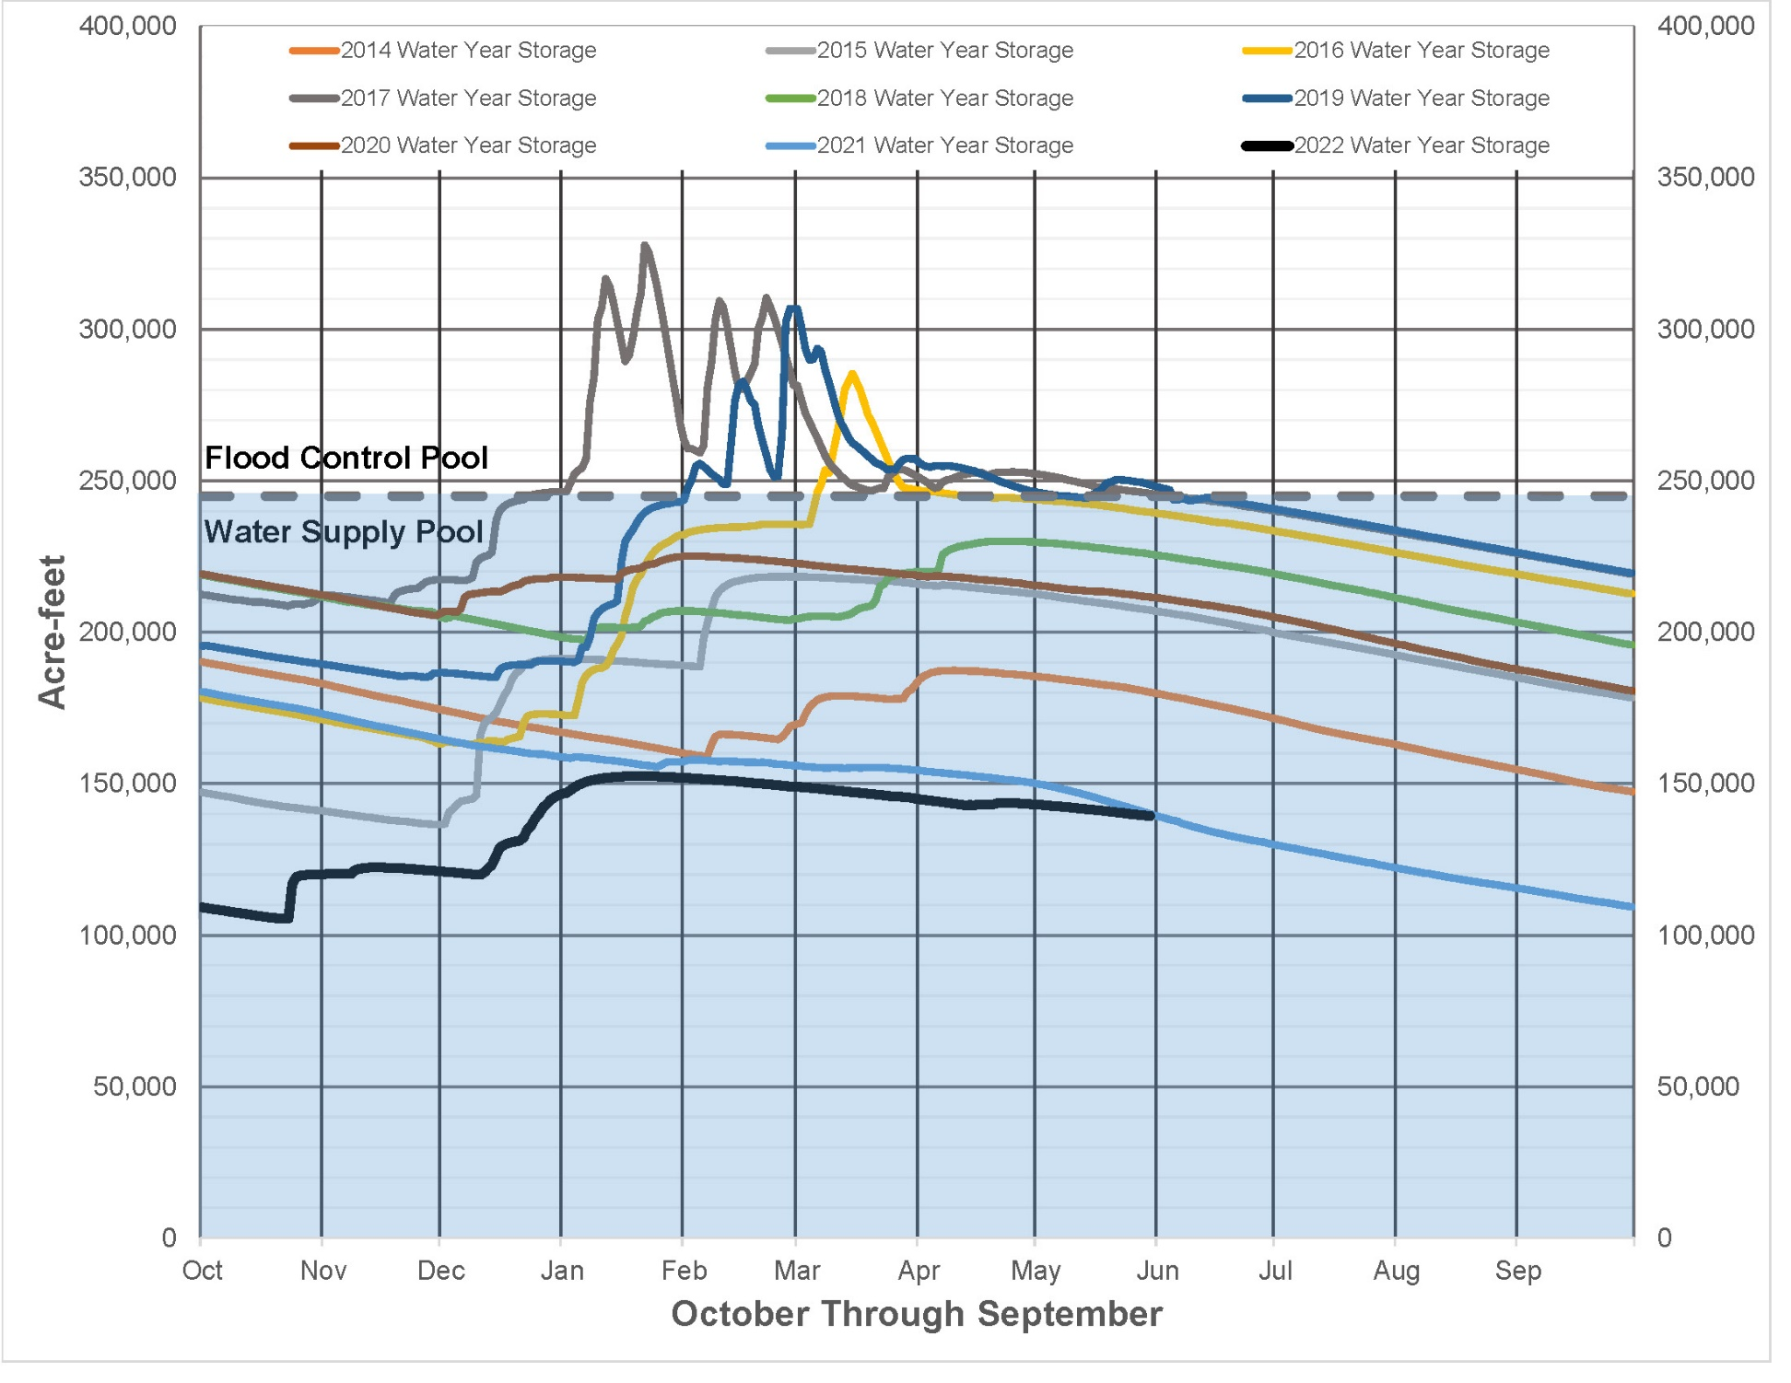
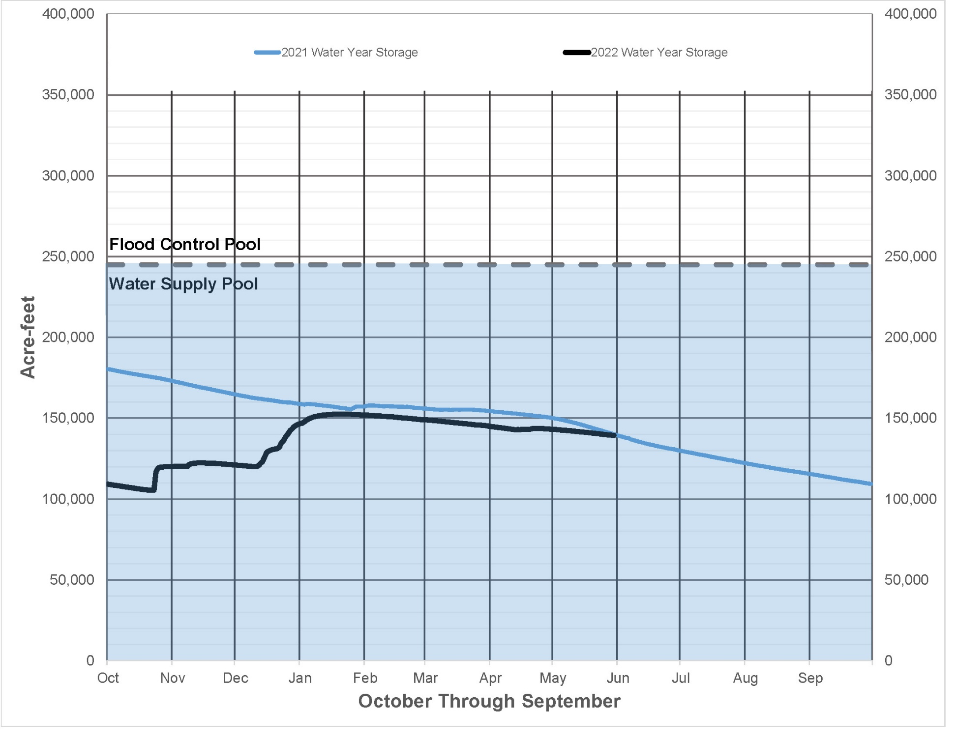
Lake Sonoma Storage

Slide 6
Lake Sonoma Storage

Slide 7
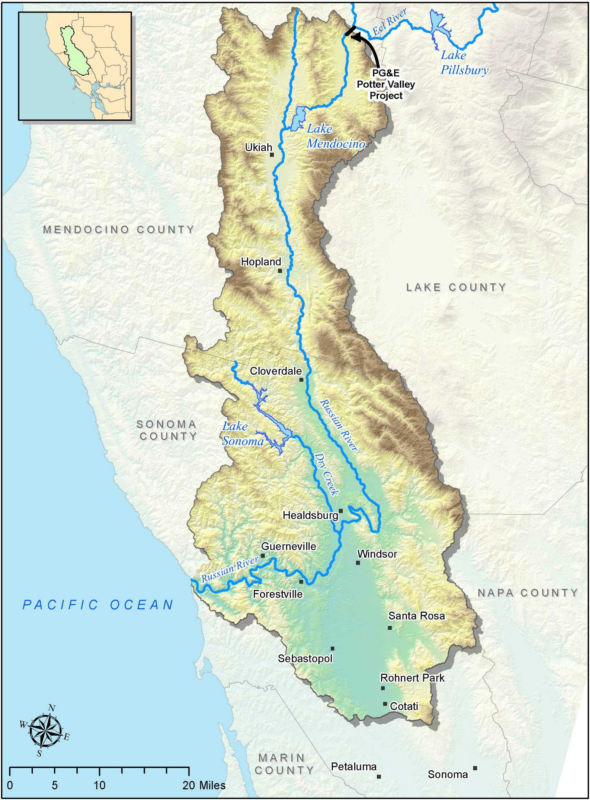
Russian River Watershed

