Slide 1
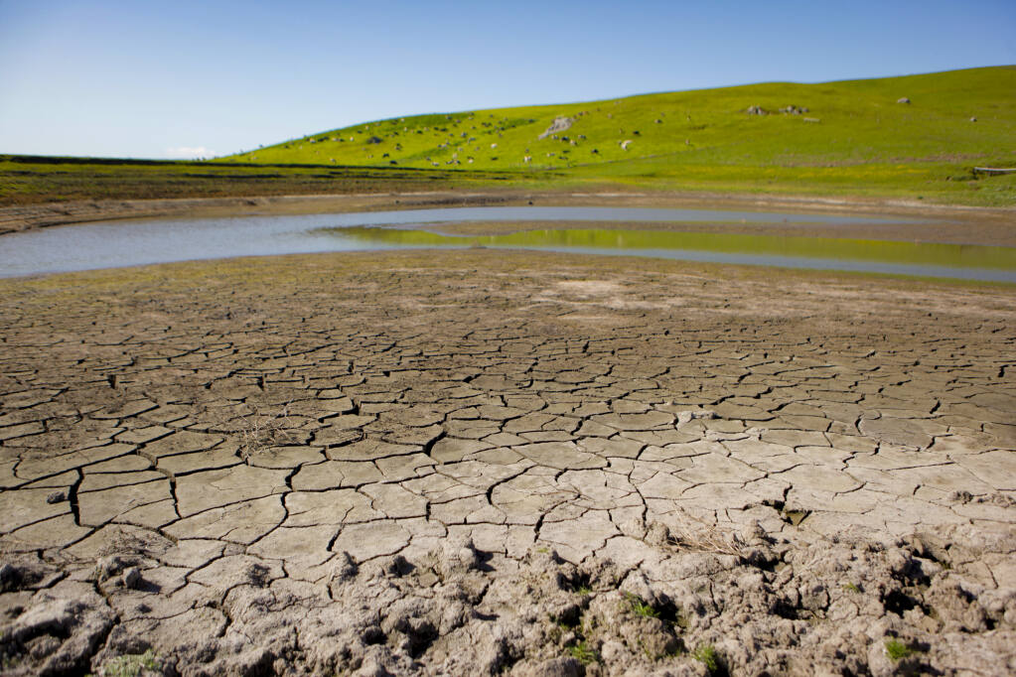
Drought Town Hall: Department of Emergency Management - Response Update

Slide 2
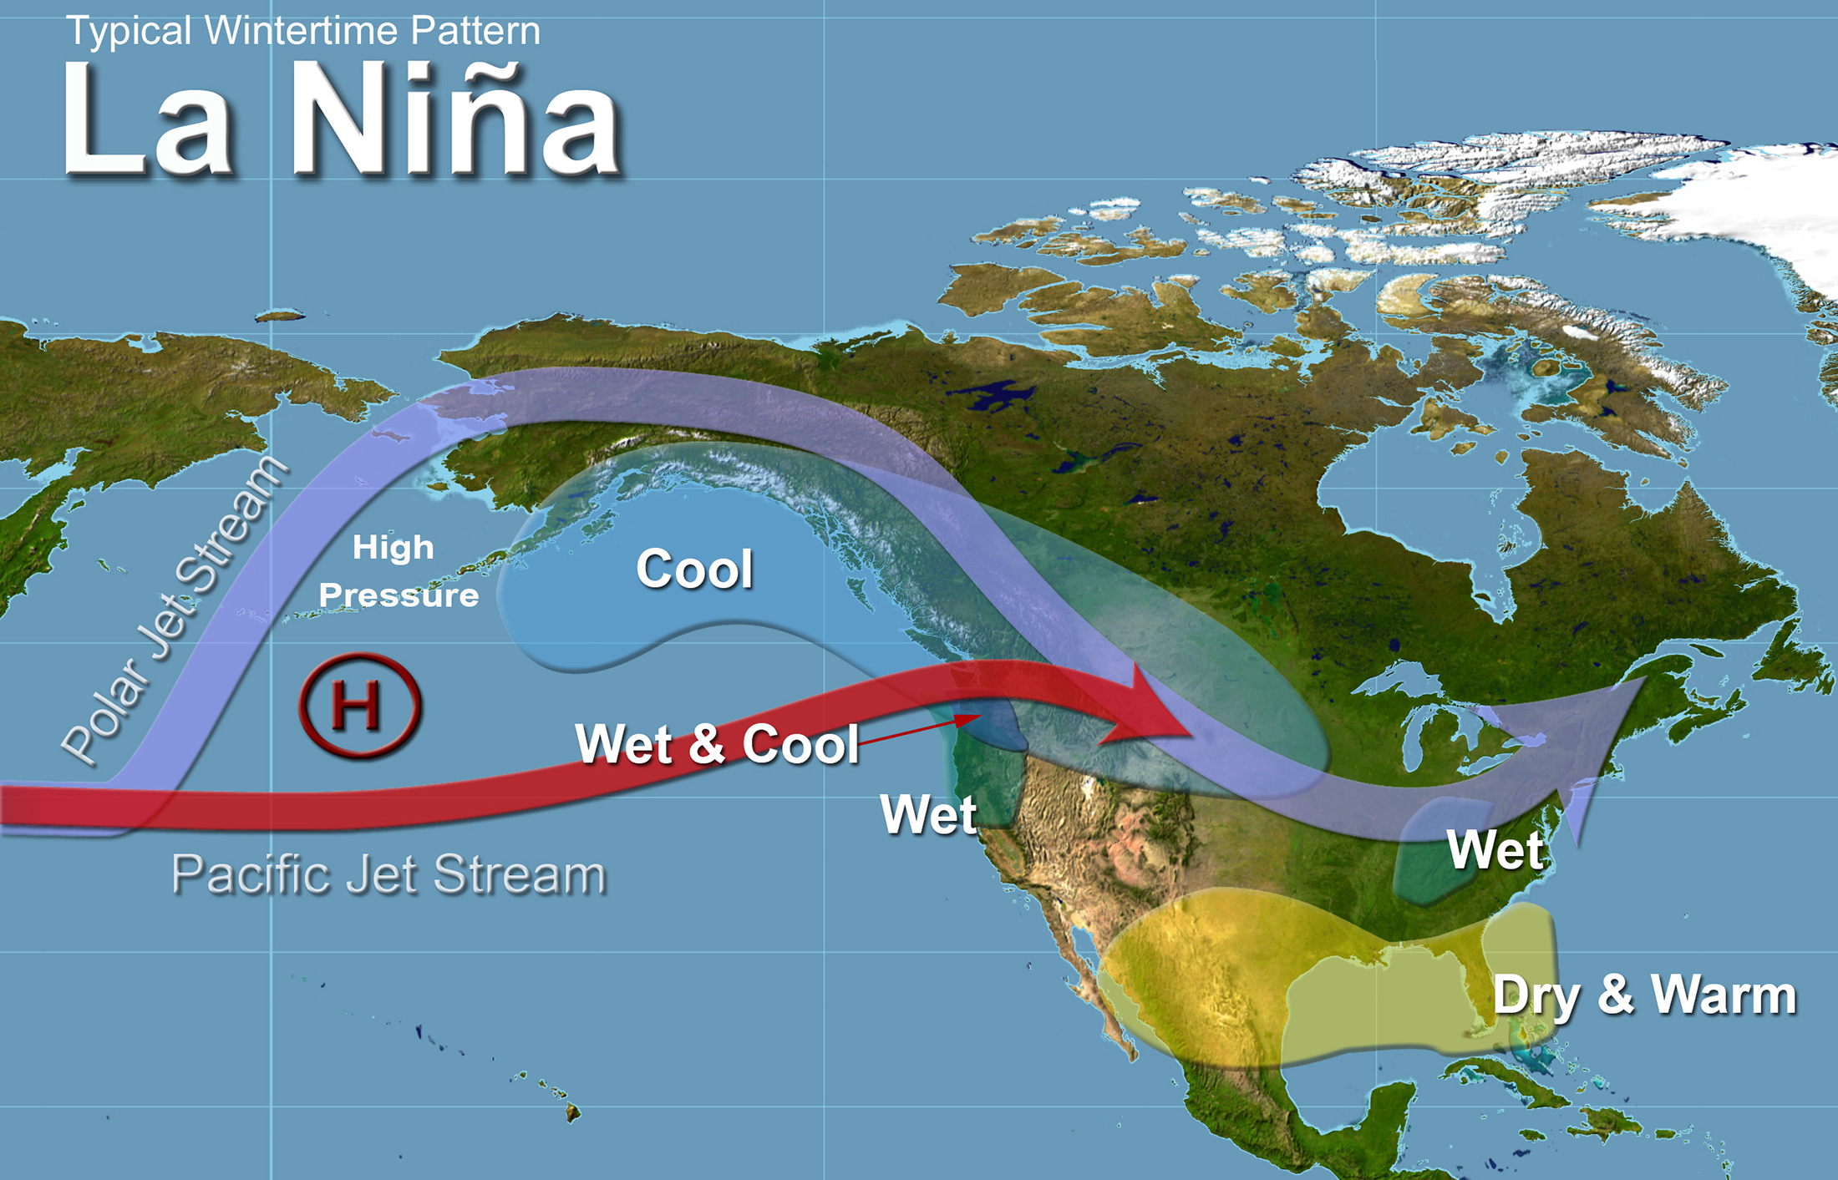
Drought Update
Dry conditions persist
Models suggesting another potentially dry winter – La Nina
Will take years of rain to fully recover
Notes:
Before _______________ provides an update on conditions, as your Director of Emergency Management, I would like to underscore the first two discussion points.
The current ocean temperature pattern called La Nina is likely to continue into the first half of winter. More likely to have a drier winter than normal. Thus, the current multi-year drought will possibly extend at least into 2023. That could produce impacts more significant than those we current face.
As you know, even with rain, it will take several years to catch up. Groundwater levels, soils moisture, and drought stressed vegetation will take years to return to “normal”.

Slide 3
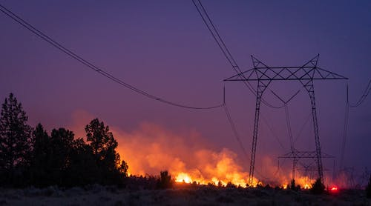
Current Drought Response Efforts
Expanding the Sonoma County Drought Task Force
Ongoing internal initial hazard assessment
Notes:
County working to expand current Drought Task Force, prepare to build on current information sharing and move into operational coordination
DEM has developed a draft internal Hazard Assessment = working to identify secondary and tertiary impacts in public safety, public health, energy, etc.) (CalAM water agreement)

Slide 4
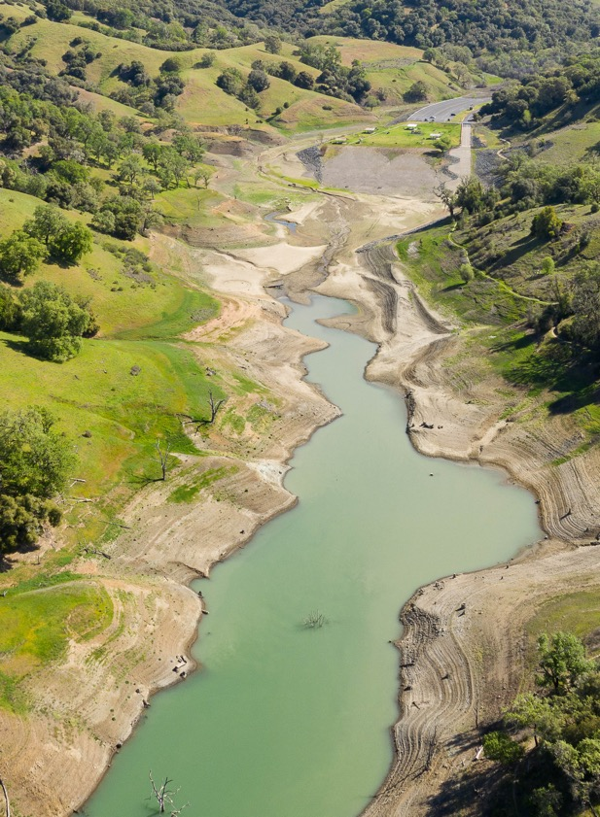
Senate Bill 552 Overview: Increased Requirements & Technical Support
Approved by Governor, September 2021
Water Shortage Contingency Plans required for small water systems (<3000 connections) including local contacts, vendors, alternative water sources, and emergency measures
Expanding Drought & Water Shortage Task Force – including small water systems, domestic wells, and GSAs
Develop County Plan including drought and water shortage risk and interim and long-term solutions for interim and emergency drinking water needs
Broader coordination with State Department of Water Resources
Notes:
The State has been kind enough to require the County to conduct activities in support of small water systems while providing us with the latitude as regards how to pay for it.
Key requirements include:
Small water systems must develop a Water Shortage Contingency Plan. A small water system is one with less than 3,000 connections. Sonoma County has more than 370 of these systems.
The County must develop a plan that includes proposed interim and long-term solutions for small water systems and domestic wells. The County plan must consider several elements:
(1) Consolidations for existing water systems and domestic wells.
(2) Domestic well drinking water mitigation programs.
(3) Provision of emergency and interim drinking water solutions.
(4) An analysis of the steps necessary to implement the plan.
(5) An analysis of local, state, and federal funding sources available to implement the plan.
Create a standing Drought Task Force (Sonoma County will expand existing Task Force to more than 40 invited members)
Note: The State plans to publish guidance for locals on how to implement SB552 by the end of the year.

Slide 5
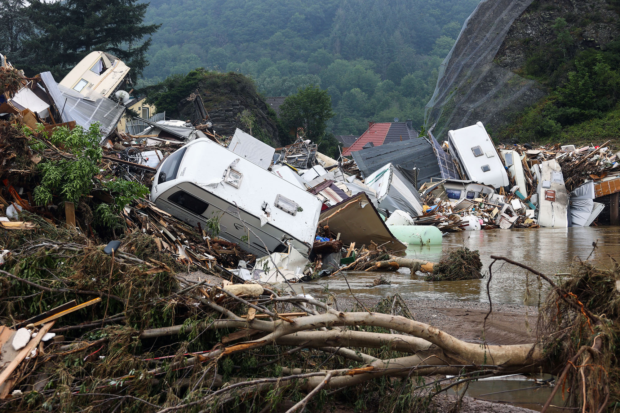
Catastrophic Drought and Flood Response Project
Enhance interagency coordination & program design for both extreme weather hazards
Enhance drought and flood plans
Provide capacity to expand and leverage existing County and Water mitigation, preparedness, and response programs
Notes:
The Board recently approved a two-year project to significantly expand the scope and reach of drought and flood response coordination efforts for Sonoma County. As the immediate drought indications indicate and as other jurisdictions face record flooding incidents - we seek to tackle the challenges of extreme climate change induced weather incidents.
This enables Water and the County to develop and sustain a full-time committed focus on preparing for catastrophic drought and flood hazards. This is not simply tweaking existing plans and programs – we need to take a hard look at these challenges and reimagine how we might empower our organizations and our communities to address those challenges.
Funding will support dedicated staff in Water and County DEM as well as enable other County departments to participate including Public Information, Information Systems, and Counsel.

Slide 6
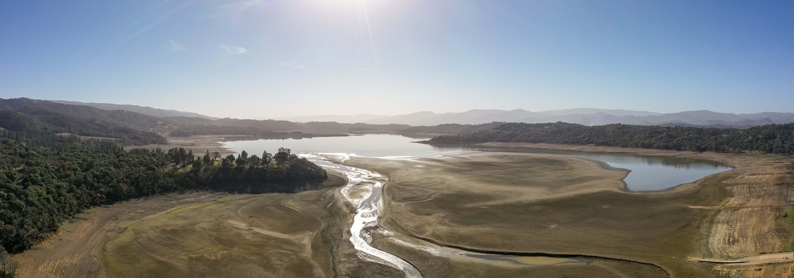
SoCoEmergency.org
Notes:
SoCoEmergency.org

