Slide 1
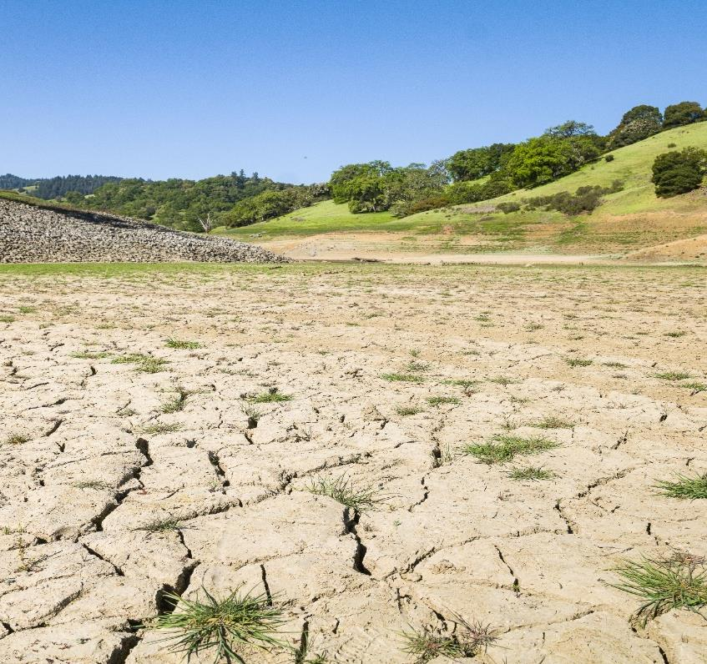
Drought Town Hall
Marcus Trotta
Principal Hydrogeologist
Sonoma Water
Notes:
Thank the host and organizer Latino Service Providers for organizing this important event.
And thank Lisa Micheli and Pepperwood for allowing us this wonderful space to gather and share. And for roping me in as keynote!
I’m honored to be here and share what I can about climate change with an emphasis on the current drought.

Slide 2
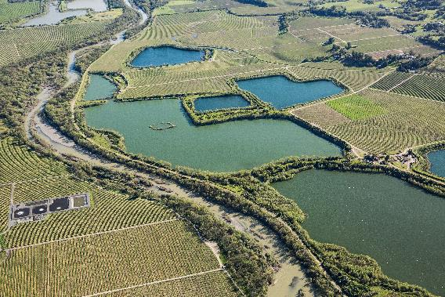
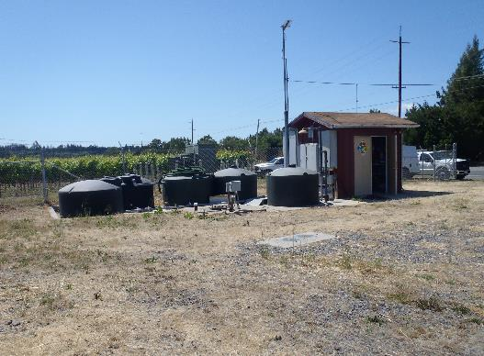
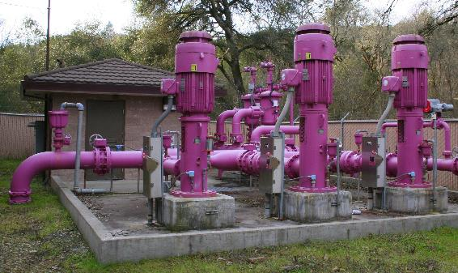
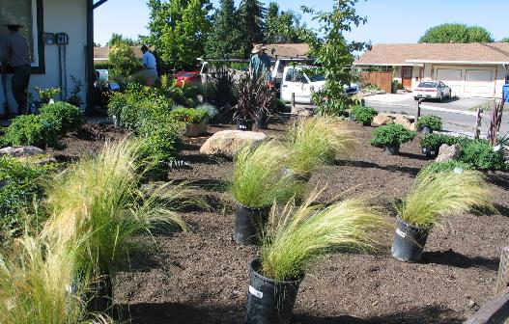
Local sources of water
Surface water (Russian River project)
Recycled water
Water that is saved through conservation
Groundwater
Notes:
Owned and operated by USACE who release water for flood control
SW ‘s interests are water supply; release water to meet the needs of more than 600,000 people living in urban areas in Sonoma and Marin counties

Slide 3
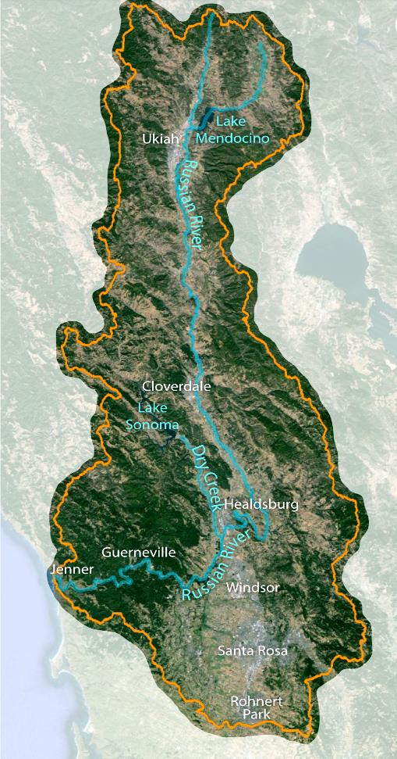
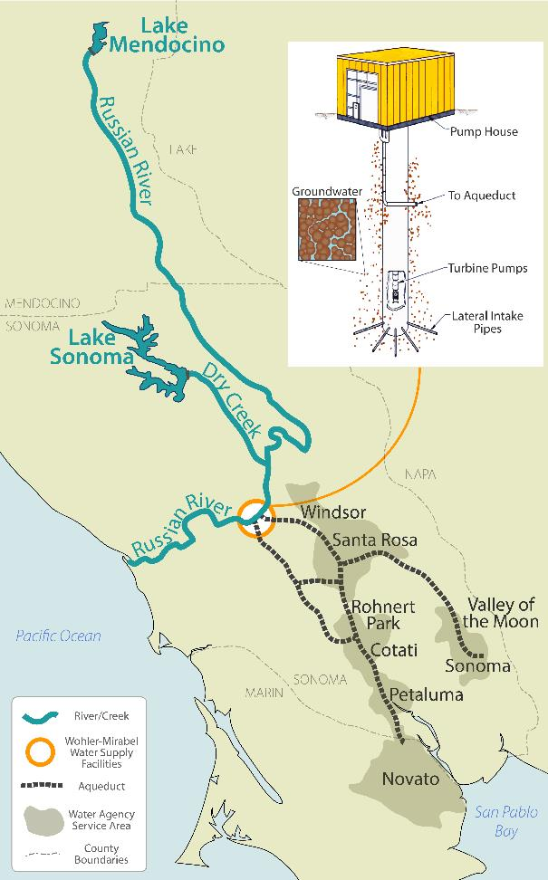
Russian River Watershed
2 major water supply/flood control reservoirs
Sonoma Water supplies water to about 600,000 residents
Water is naturally filtered through sands/gravels at Wohler/Mirabel facilities (near Forestville)
Notes:
Owned and operated by USACE who release water for flood control
SW ‘s interests are water supply; release water to meet the needs of more than 600,000 people living in urban areas in Sonoma and Marin counties

Slide 4
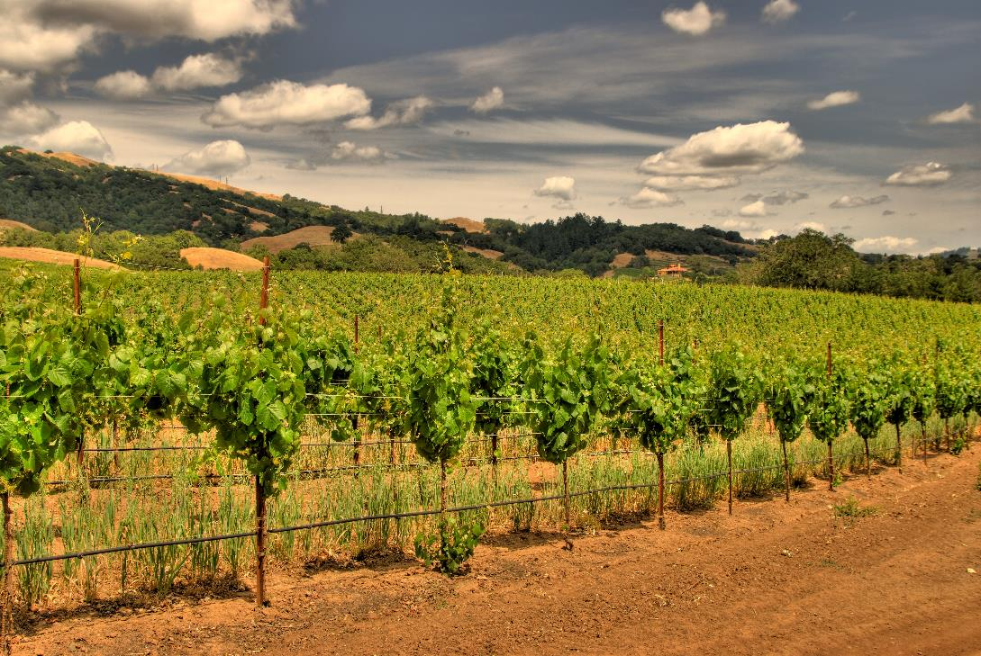
Recycled water
Highly treated wastewater
Used for agricultural irrigation, in parks, on playing fields, for landscaping and environmental restoration
Notes:
Owned and operated by USACE who release water for flood control
SW ‘s interests are water supply; release water to meet the needs of more than 600,000 people living in urban areas in Sonoma and Marin counties

Slide 5
Water Conservation
Notes:
Water conservation has been and will continue to be a key tool to resiliency.
While our population has increased since the mid-1990s, as shown in the gray line, per capita water consumption has dropped significantly.
In the mid 1990s, consumption was around 160 gallons per person, per day. Now, it’s less than 100 gallons per day, on average in our region.
This metric includes all uses of water (residential, commercial, industrial, institutional, landscape irrigation, water loss, etc.)
During the current drought, Sonoma Water is reducing the water supplied to our customers by 20% -- which is why we’re asking people to save even more.
Conservation can’t do it all…

Slide 6
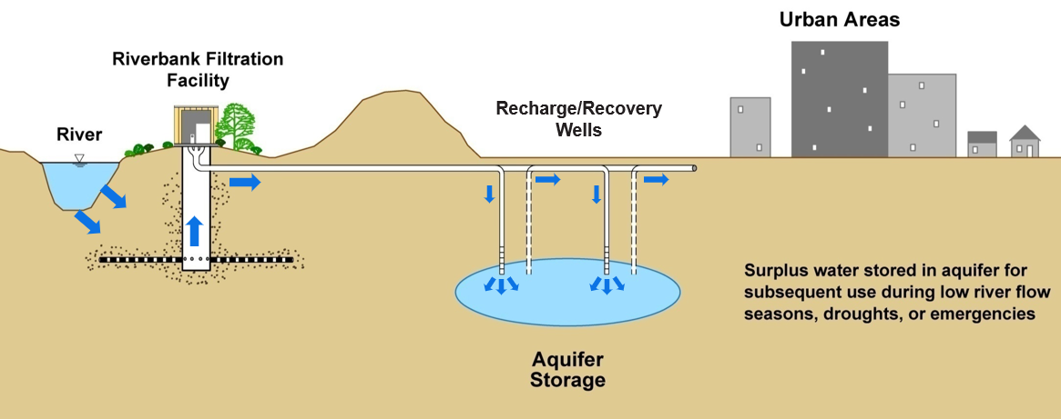
Balancing water supply through conjunctive use
Maximize recycled water use and water conservation
Let groundwater aquifer recharge and recover when Russian River water is available
Actively supplement aquifer during winter when water is plentiful

Slide 7
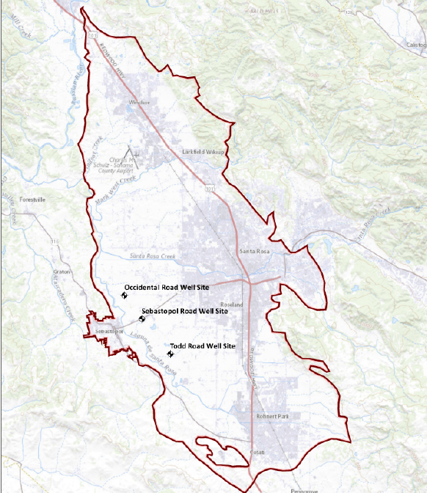
Groundwater – Sonoma Water Facilities
Three production wells in Santa Rosa Plain (Todd Rd, Sebastopol Rd and Occidental Rd.)
Between 1999-2009, wells averaged 3,600 acre-feet annually
After 2009 shifted to conjunctive use (rest wells during normal/wet years and pump during dry years)
Relied upon wells during 2012-2015 drought
Have been offline since 2018 (upgrades needed to comply with recent drinking water regulatory changes)

Slide 8
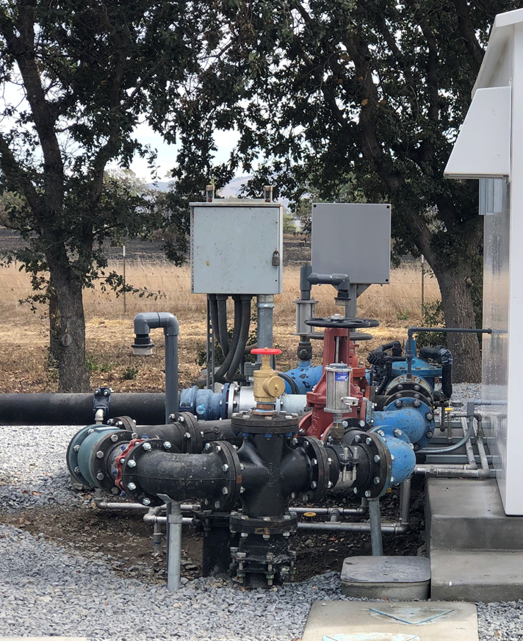
Santa Rosa Plain Wells Drought Resiliency Project – First Phase (Completed 2021)
Upgraded the water treatment at Todd Road well to bring online and help with current drought
Well was re-activated in October 2021 and has been in production Summer 2022 providing approximately 1.5 million gallons per day of water to supplement Sonoma Water’s deliveries from the Russian River

Slide 9
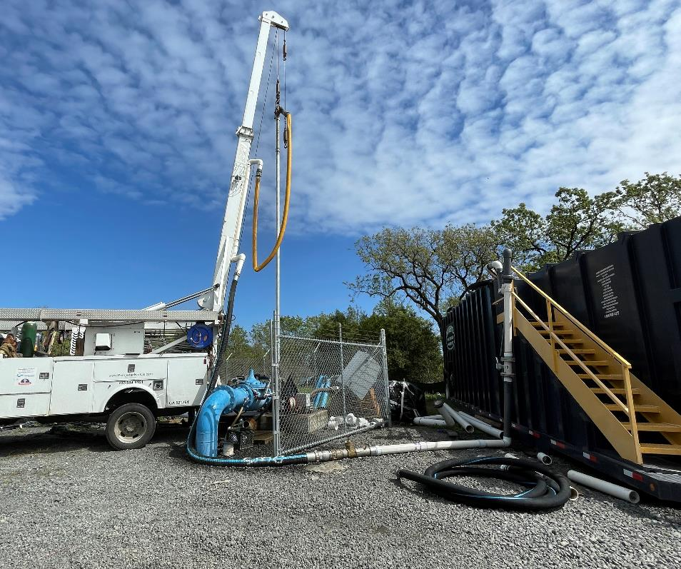
Santa Rosa Plain Wells Drought Resiliency Project – Subsequent Phases
Project awarded $6.9M State Drought Relief Grant
Sebastopol Rd Well (work underway)
Test, design and upgrade existing well
Bring online for production asap
Plan, permit, test and implement recharge components (2023-2025)
Occidental Rd Well (in planning phase)
Downhole testing to inform design of new well
Construct new well in 2023 capable of standard production and recharge operations
Plan, permit, test and implement recharge components (2024-2025)

Slide 10
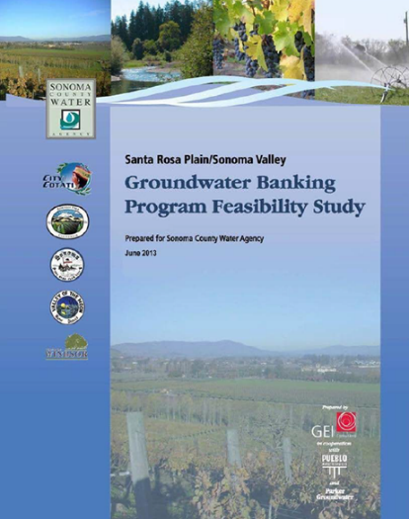
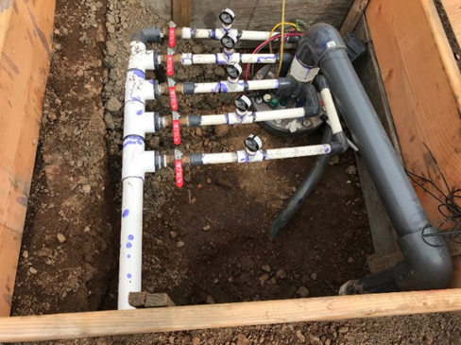
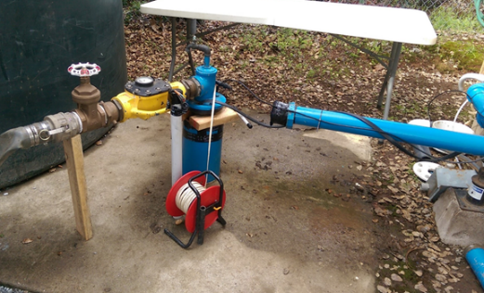
Aquifer Storage and Recovery
Actively supplement aquifers with Russian River drinking water when it’s available
Successfully and safely implemented in many other areas throughout world
Increases supply portfolio with groundwater being more readily available during droughts and emergencies
Requires coordinated planning and permitting with extensive monitoring and reporting
Build upon and leverage prior and ongoing studies and planning in Sonoma County
2013 Regional Groundwater Banking Feasibility Study
2018 City of Sonoma ASR Pilot Study
Ongoing Implementation of Groundwater Sustainability Plans
Regional Water Supply Resiliency Planning

Slide 11
QUESTIONS?
Marcus Trotta
Marcus.Trotta@scwa.ca.gov

