Slide 1
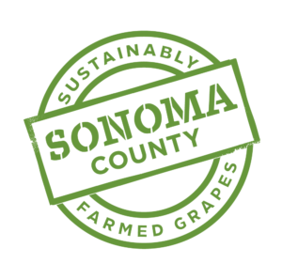
Drought Town Hall
Vineyard and Winery Water Conservation
Brad Petersen
Vineyard Manager – Silver Oak Cellars/Twomey Cellars

Slide 2
How much water is available? Where is it coming from?
Well monitoring to determine health of aquifer if ground water is used.
Measure the depth to water level daily/weekly throughout the year.
Stored winter rainfall.
How full is your pond?
How many acres will that water irrigate.
Water rights –SWRCB regulations
How many ac-ft will the State Water Resources Control Board allow you to pump in which months?
Water rights curtailments
Groundwater
Irrigation pond
Riparian
Notes:
The key to any kind of conservation effort is to know where you are starting from. As part of our sustainability efforts these are water sources that we monitor on a regular basis.

Slide 3
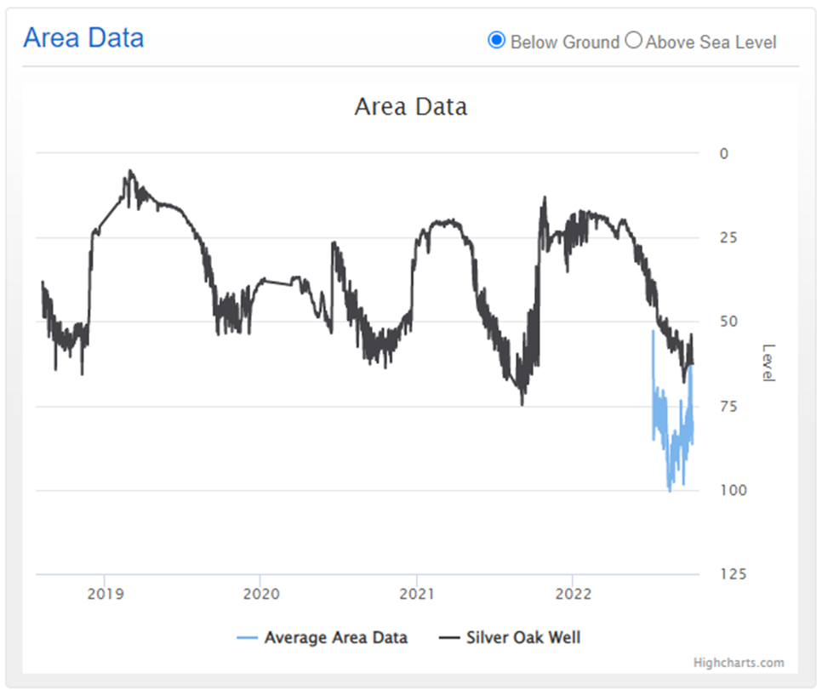
Well monitoring
Wellintel sounder- monitors water level hourly
Wireless data transfer to website.
Notes:
We use a sounder that sends a pulse down the well and measures how long it takes for the sound to return to the sensor. These measurements are taken hourly and graphed over the course of the year. When we compile data for the past 4 years we can see that this aquifer does drop as the season progresses. With winter rainfall the water level quickly recovers even in the past two years of drought. The black line shows our well. The blue line is an average of the other wells in the area that are being monitored by the same company.

Slide 4
Water conservation-vineyard
Monitor soil moisture - know how much water the vines have to start the season
Monitor shoot growth- only grow enough canopy to ripen the crop load.
Extra shoot growth requires more water, more canopy management, more expense
Monitor vine water status – how much water is the vine using?
Porometer
Sap flow
Pressure bomb
Check drip irrigation systems for leaks and efficiency regularly.
Flowmeter readings vs system design flows
Irrigate at night to reduce evaporation
Notes:
As part of a sustainable farm plan we want to apply the minimum amount of water to the vines at the correct point in the growing season to produce the amount of crop we need to stay in business. We determine what this amount is by monitoring soil moisture, shoot growth during the growing season and vine water status.

Slide 5
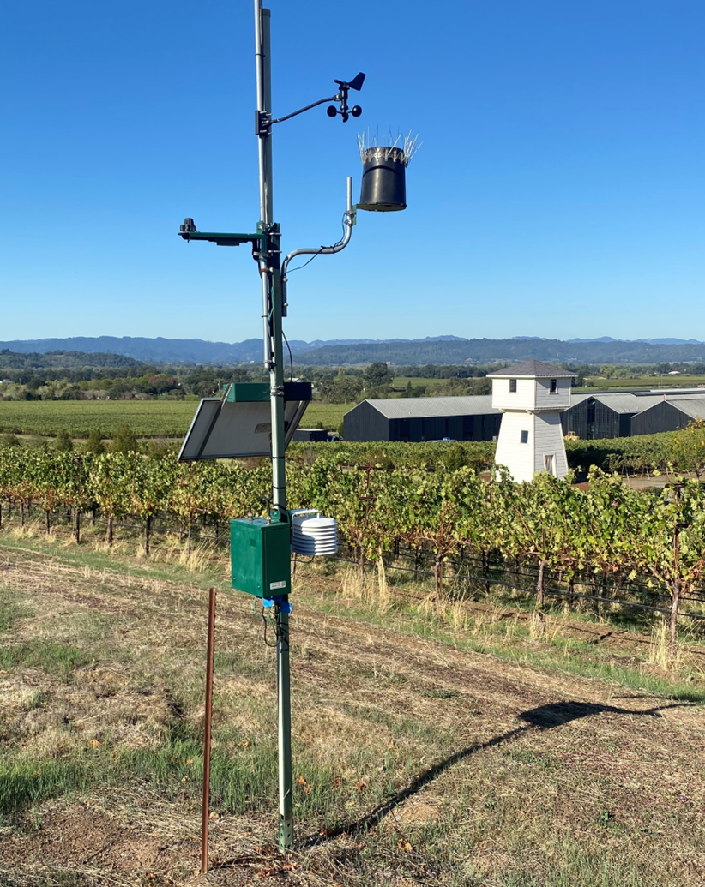
Soil moisture monitoring
.
Weather stations measure rainfall, temperature, humidity and other useful Information.
7-8” of rainfall in the spring will refill the soil moisture
profile.
Vines require another 1/4 to 1/2 ac-ft per acre of irrigation during the growing season.
Notes:
At the beginning of the season the vines will start growing using the soil moisture replenished from winter rainfall. As part of a sustainable farm plan we want to apply the minimum amount of water to the vines at the correct time to produce the crop we need to cover expenses. Having enough spring rainfall is important to get the vines off to a good start.

Slide 6
Soil moisture probes tell us how much water is available in the soil.
If sufficient water is available:
No Need to Irrigate
Notes:
On of the many sensors that can be added to a weather station is a soil moisture probe. These are installed in the vineyard next to a vine and can measure the relative amount of water in the soil at 8-inch intervals down to 4 feet.

Slide 7
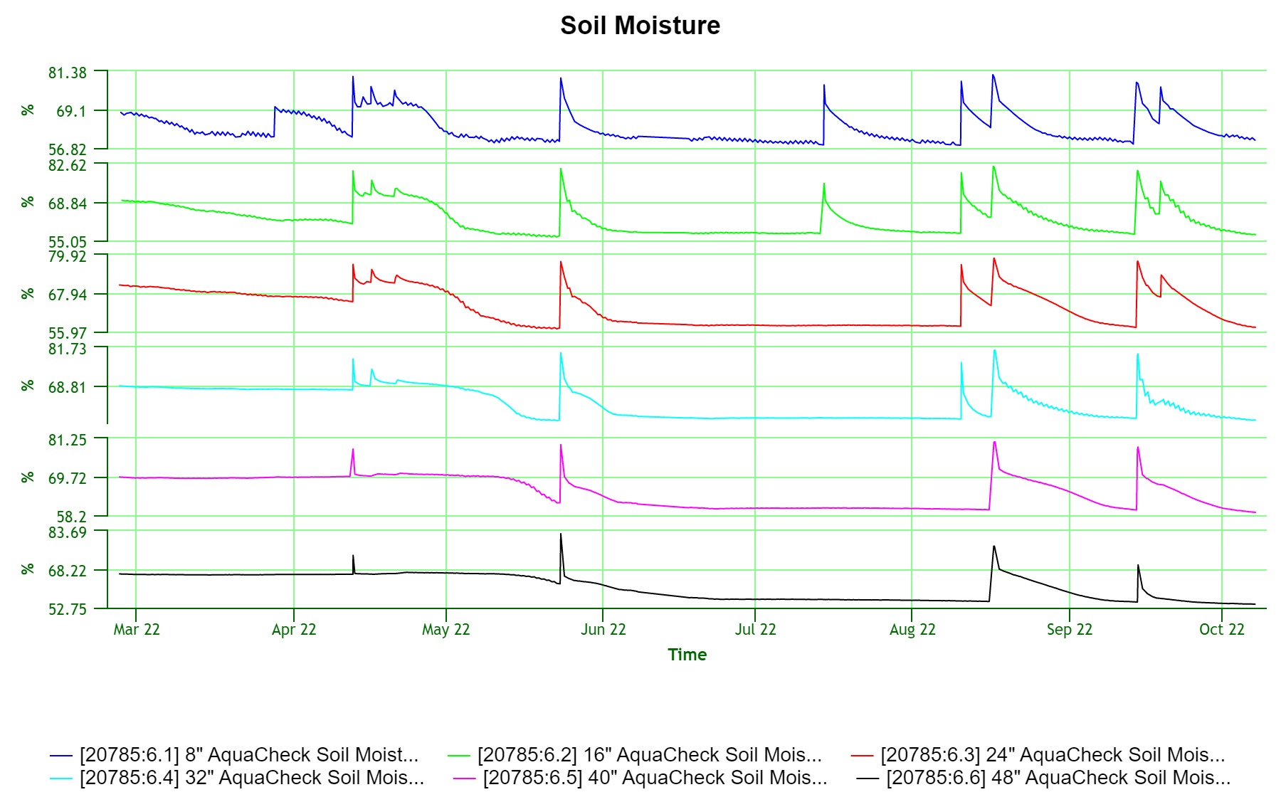
Irrigations
9/18 rain
Notes:
This graph shows soil moisture during this past growing season, March through the 7th of October. The vertical green lines represent the first of each month. The top blue line is soil moisture at 8” deep, the black line at the bottom is 4’ deep. The smaller jumps in the springtime are rain events. The larger jumps later in the season are irrigations.

Slide 8
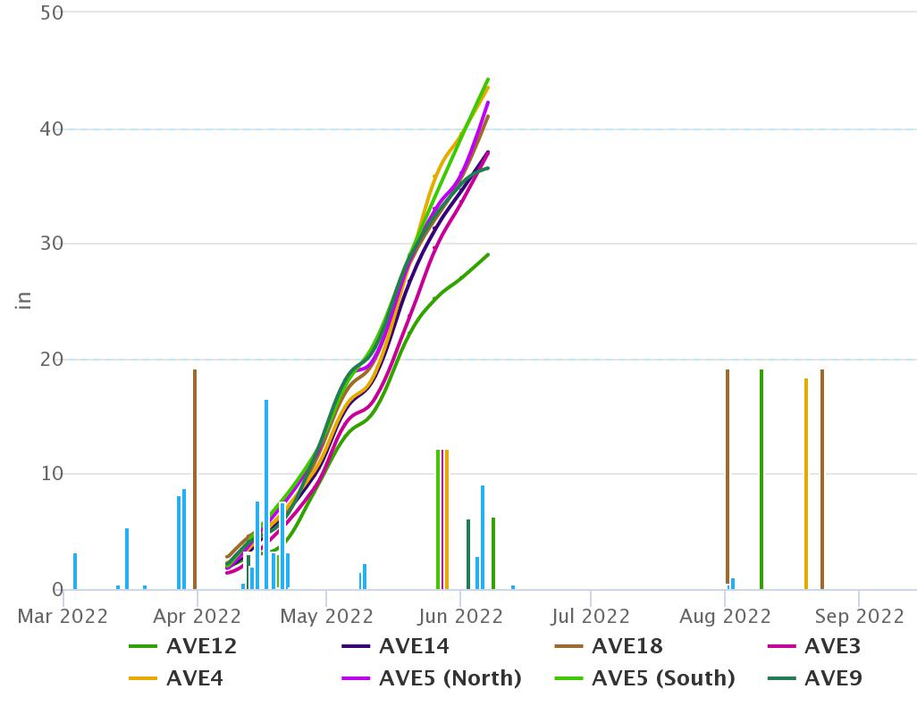
Shoot growth
2-3 representative vines per block selected and marked
2 shoots per vine are flagged
These two shoots are measured weekly throughout the growing season.
Notes:
By measuring shoot growth, we can determine if we have enough canopy to ripen the crop we left during pruning. If we reach the shoot length we need, there is no need to irrigate prior to this. Once the shoots have stopped growing and the active shoot tips dry up and fall off, irrigations may be necessary.

Slide 9
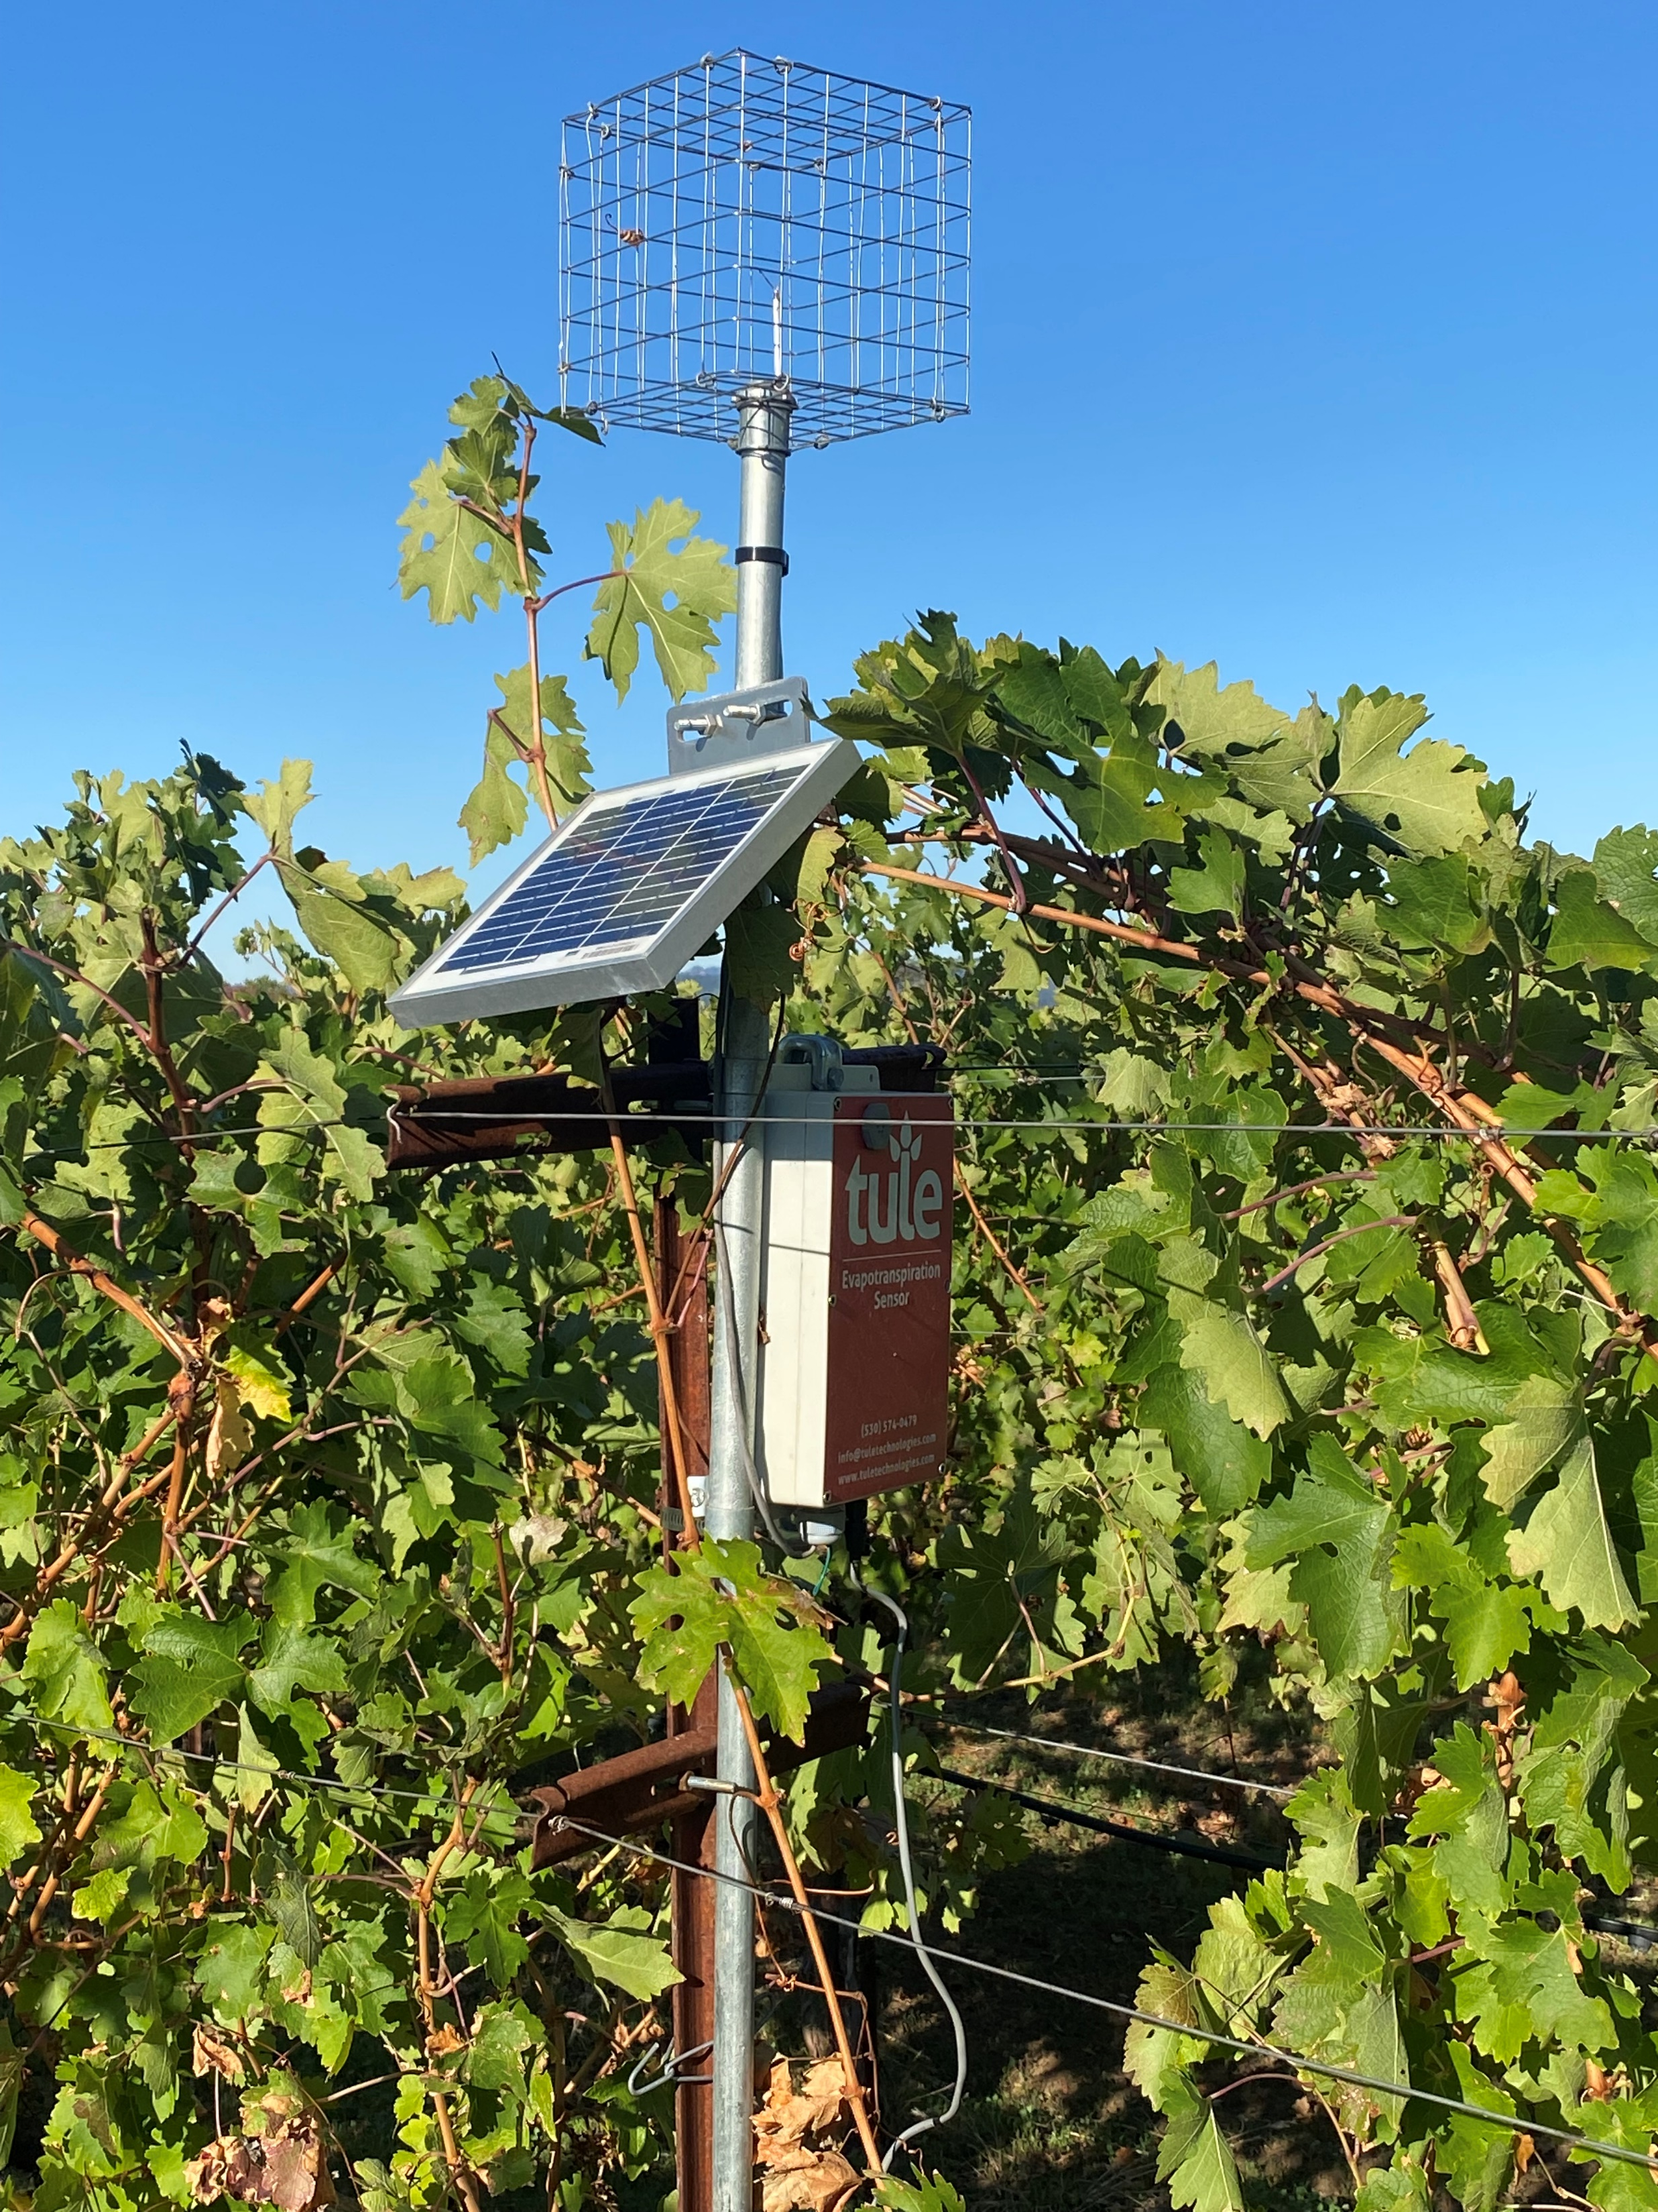
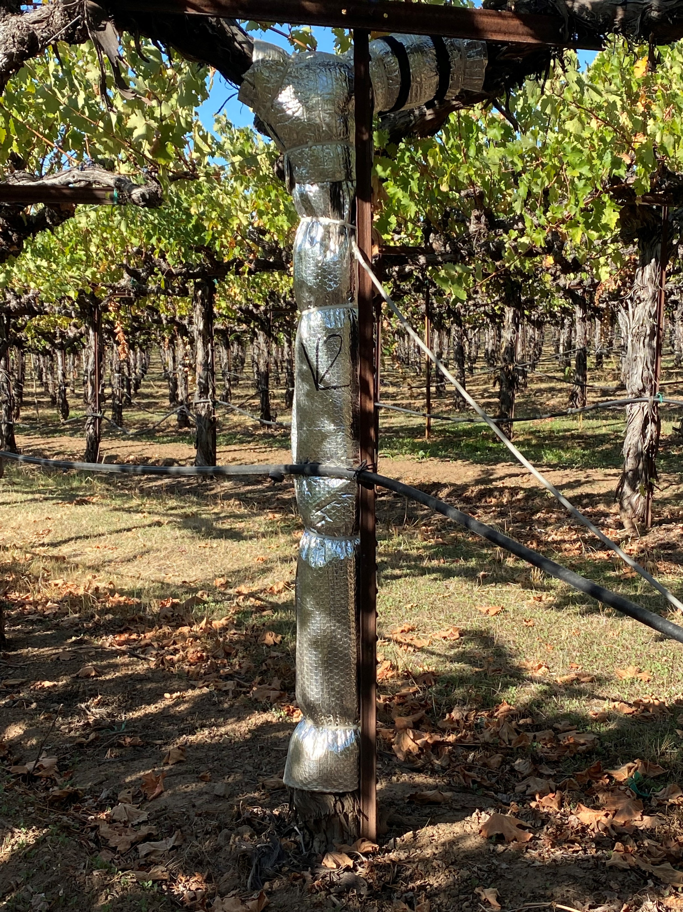
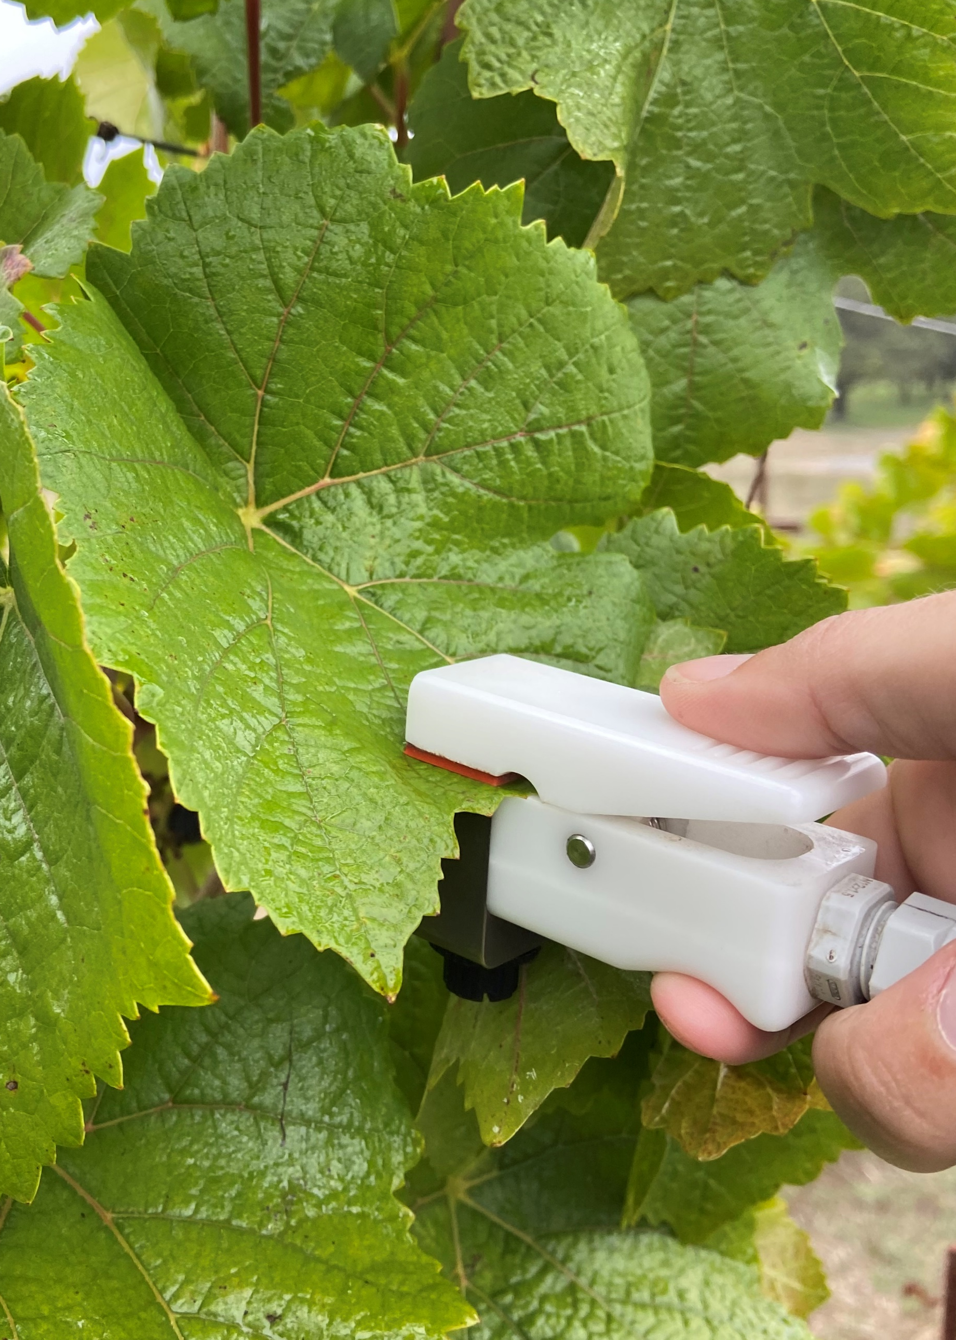
Vine water status
Water loss through evapotranspiration.
How much water are the vines using?
Porometer
Sap flow monitoring
Notes:
To determine when to irrigate we use a variety of tools. The sap flow monitor measures how fast the sap in the vine is moving from the root system up through the plant and out the leaves. The slower the flow of sap, the more water stress the vine is under.

Slide 10
Water conservation-winery
Recycle all water used in production.
All water used in winery is sent to a MBR for treatment.
Use recycled water where possible
Initial washdown of dirty tanks, equipment, floors, etc.
Using a combination of recycled water and low water use fixtures, we have reduced our potable water use by 73.96% in the winery offices and 96.67% in the tasting room.
Irrigation of vineyard when discharge of excess water is necessary
Drought tolerant landscaping
All landscaping is native or adapted plants and is irrigated with recycled water.

Slide 11
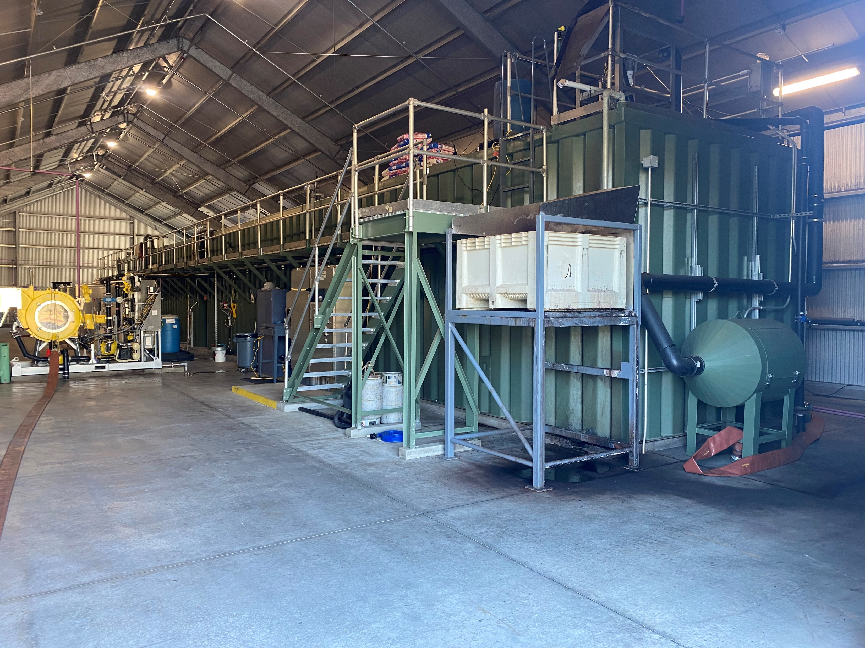
Membrane Bio-reactor, MBR
All wash water collected in the winery is sent to the MBR.
Uses biological process to remove organic material and other solids from waste water.
The result is clean water that can be used again for winery sanitation reducing our potable water use by 37%.

Slide 12
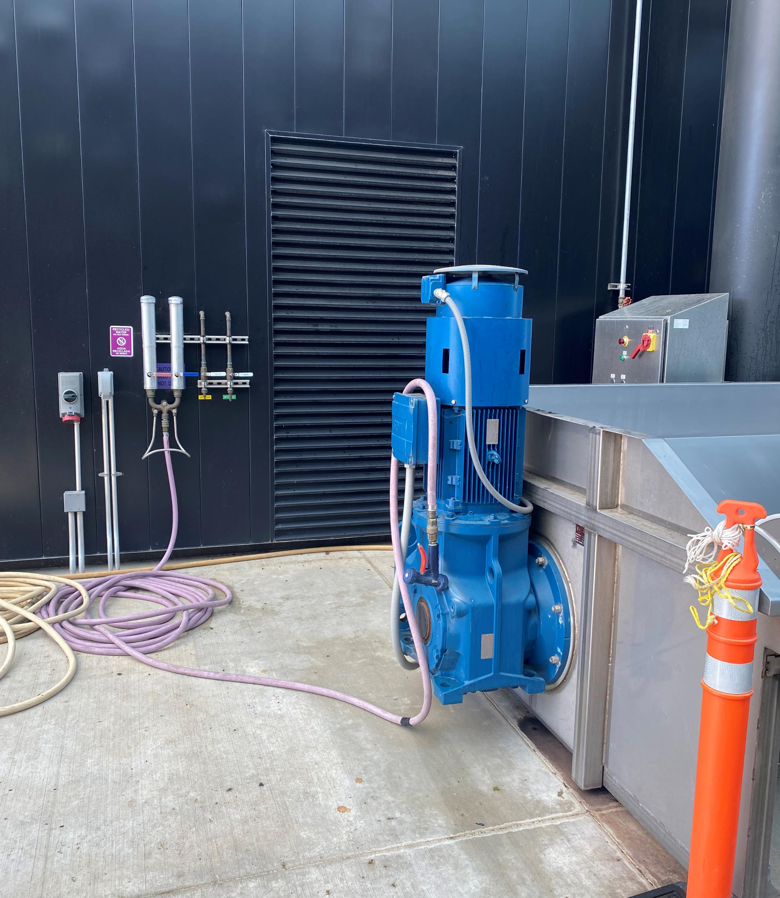
Recycled water use
Recycled water is used for initial cleaning of tanks, equipment, floors etc.
Restrooms throughout the facilities use recycled water for flushing.

Slide 13
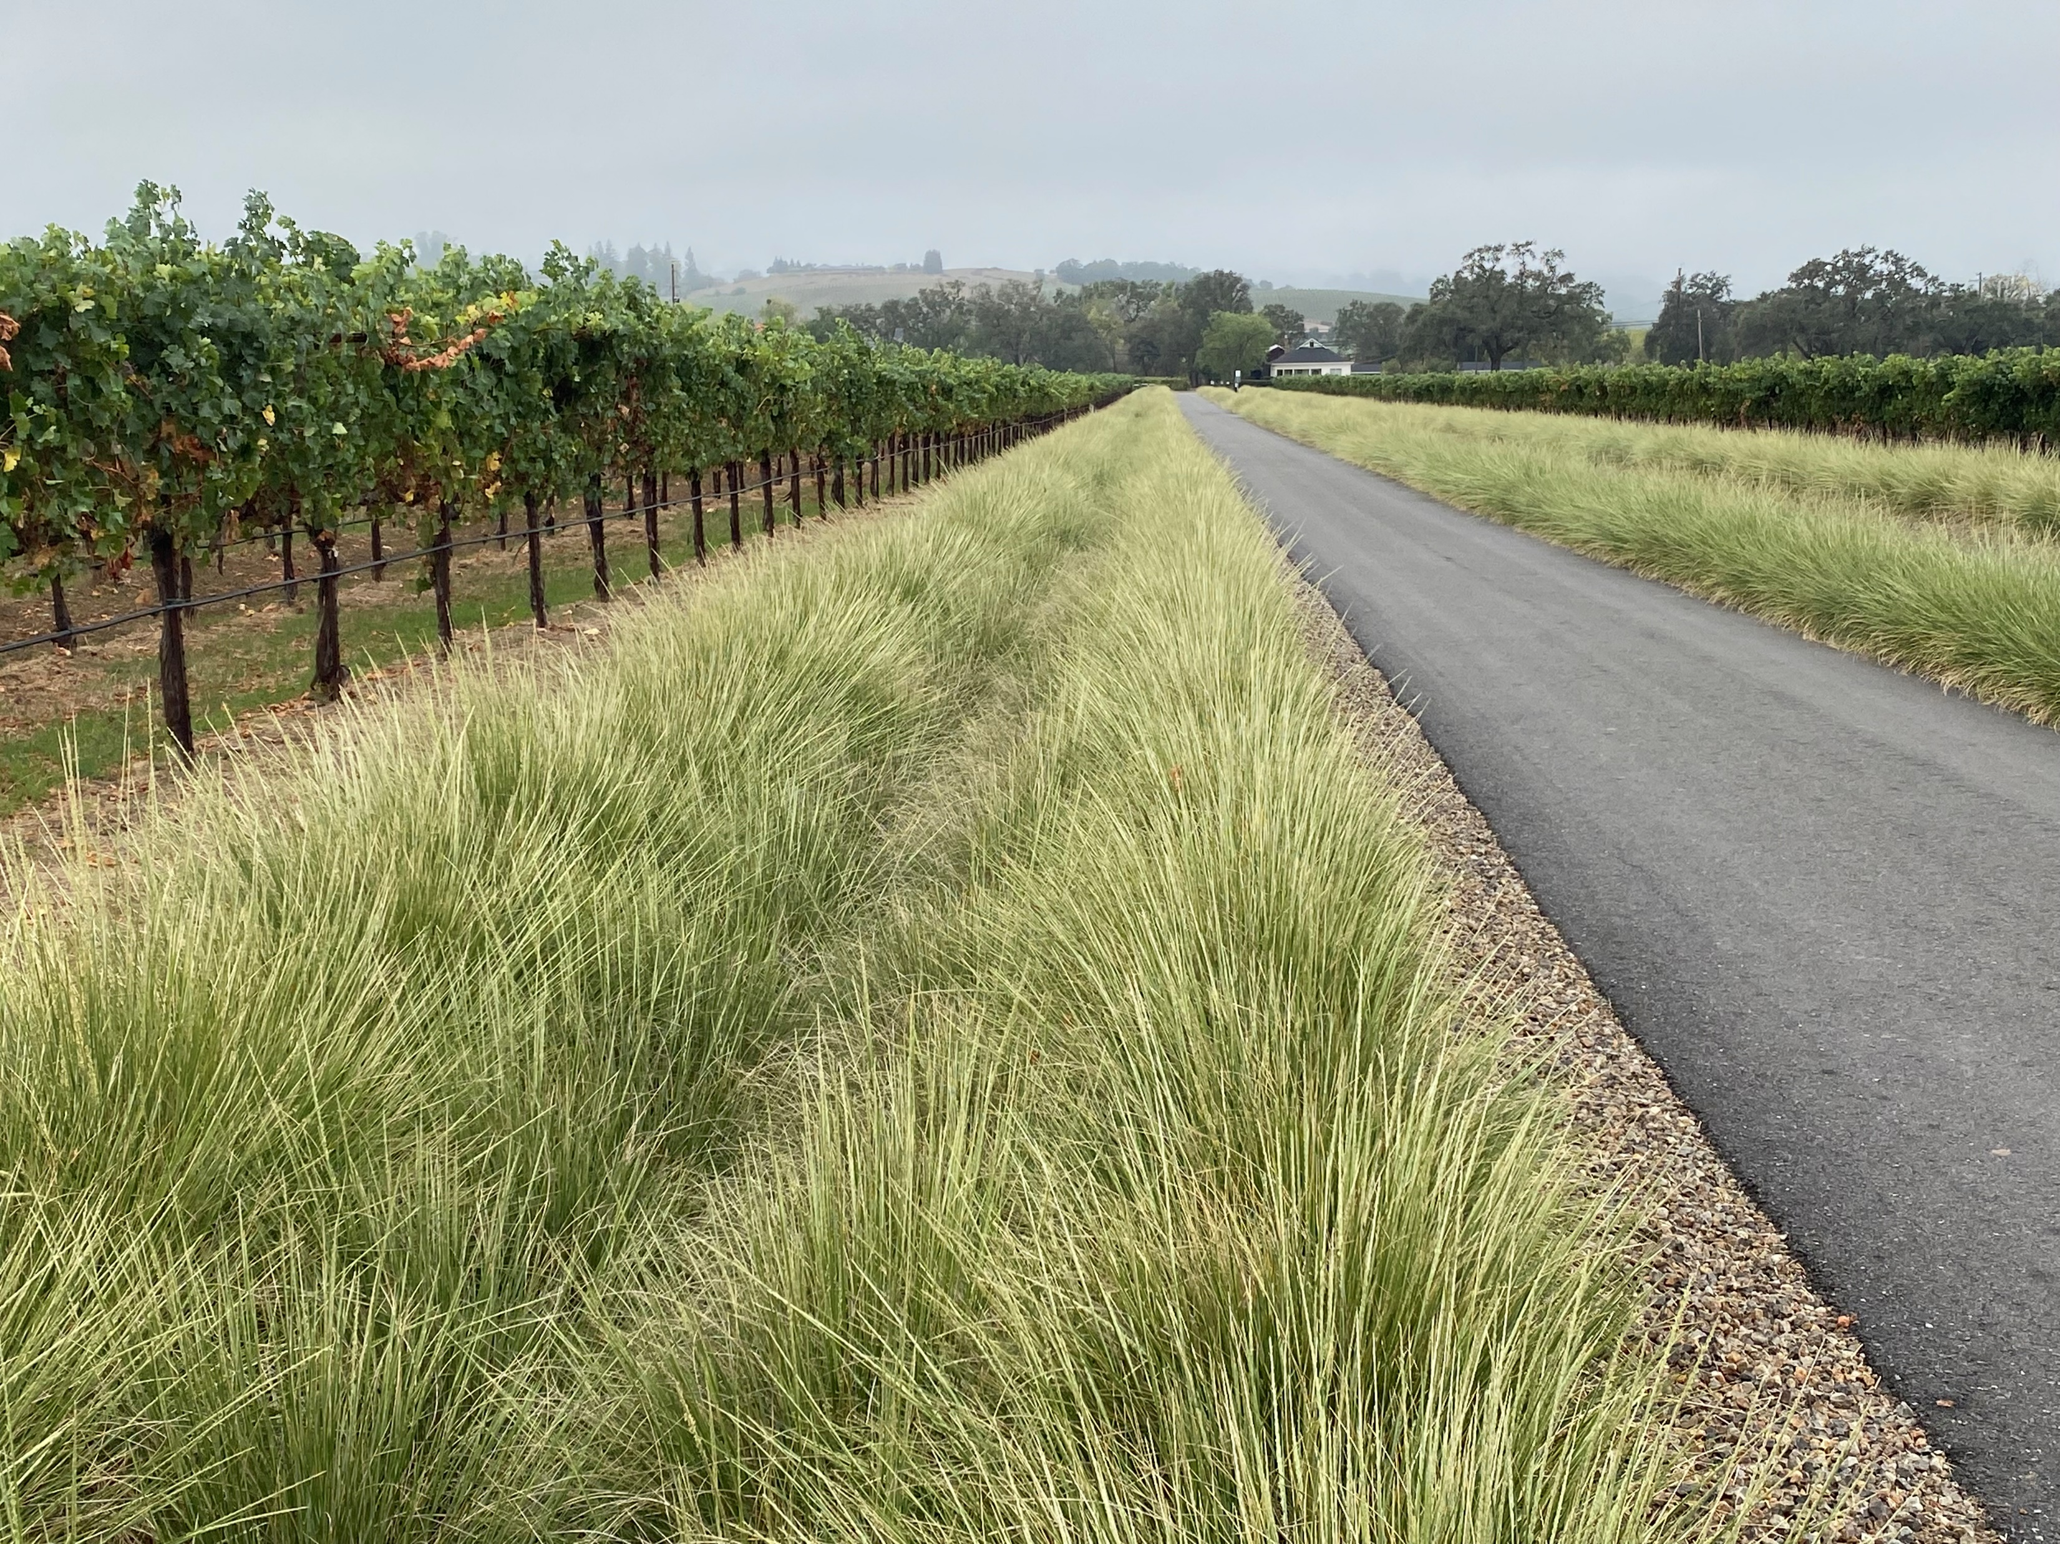
Landscaping
Drought tolerant landscaping
Native plants that require low or no water use once established
Infiltration swales used along all roadways to collect rainwater and return it to the aquifer

