Slide 1
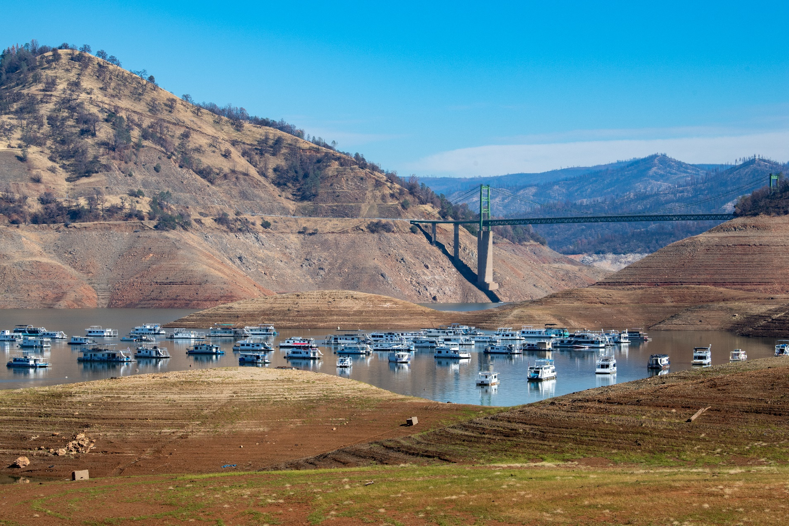
Drought, Statewide Perspective
Jeanine Jones, California Department of Water Resources

Slide 2
Water Year 2022
Third dry year. Statewide precipitation 76% of average, & April 1st snowpack 37% of average
CVP: zero supplies to most agricultural contractors except Friant Division (second year in a row), 18% to Sacramento Valley water rights settlement contractors & wildlife refuges, health & safety allocation to M&I contractors
SWP: 5% allocation, 50% to Feather River water rights settlement contractors
Increased drought impacts in Sacramento Valley, including CA Rice Commission estimate of ~50% reduction in Sacramento Valley harvested rice acreage, affecting Pacific Flyway migratory waterfowl

Slide 3
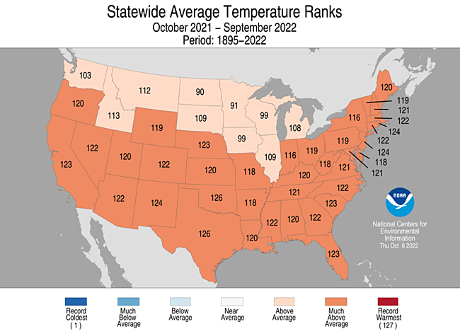
Statewide average temperature ranks

Slide 4
Statewide reservoir storage end of september
Water Year | Statewide Reservoir Storage end of September (MAF) | Percent of Historical Average
2022 | 14.7 | 69*
2021 | 12.5 | 58
2020 | 20.2 | 93
2019 | 26.9 | 124
2018 | 21.5 | 99
2017 | 25.9 | 120
2016 | 17.8 | 82
2015 | 11.9 | 55
1977 | 7.8 | 36
*Projected

Slide 5
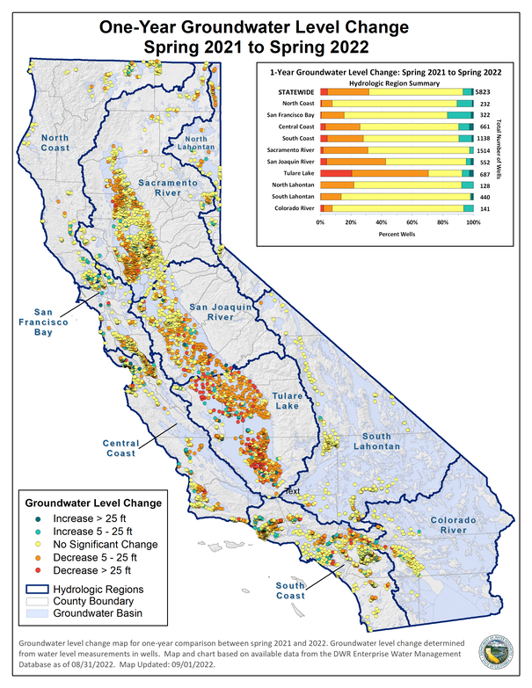
One year groundwater level change spring 2021 to spring 2022

Slide 6
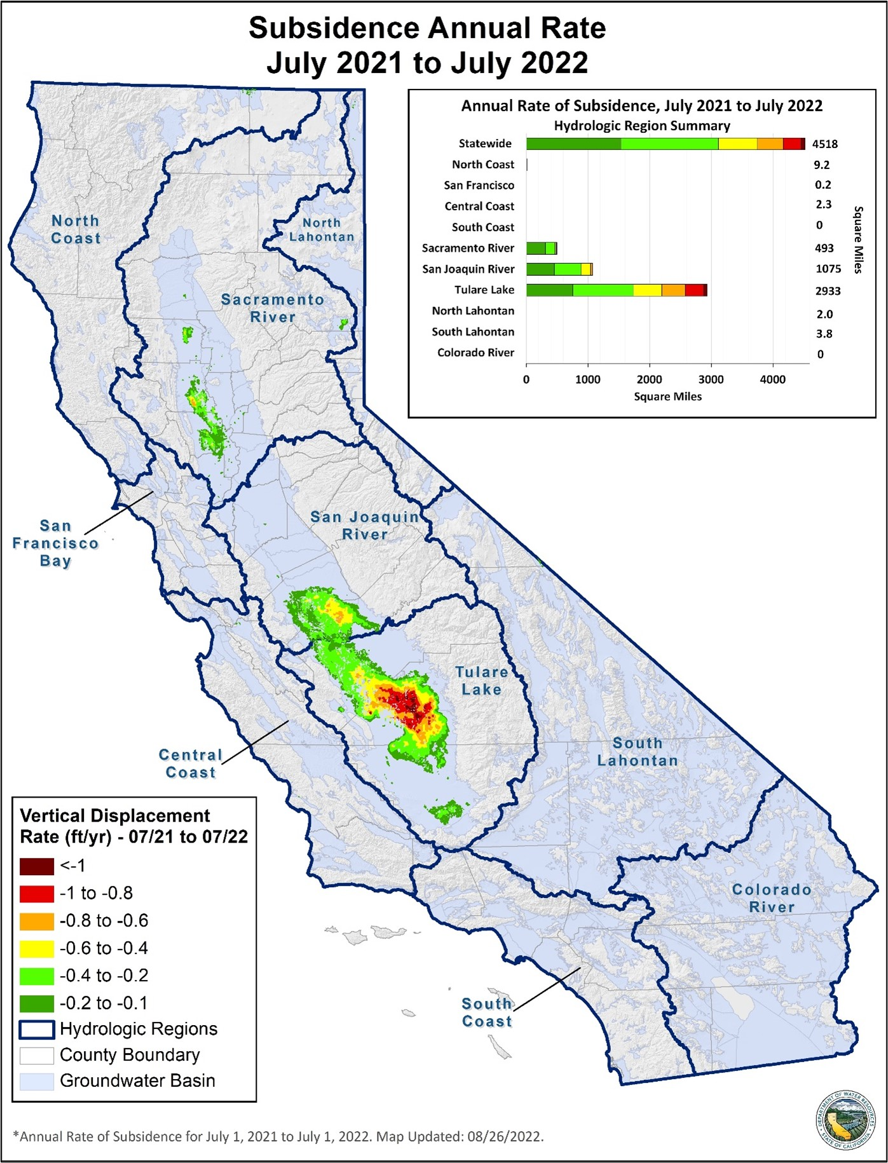
Subsidence annual rate July 2021 to July 2022

Slide 7
North Coast Hydrologic Region
PRISM data, period of record: 1981-present
Water Year 2020 precipitation: 61% of average
Water Year 2021: 60%
Water Year 2022: 75%

Slide 8
2012-16 Drought
Very dry hydrology, especially in Southern California
Included warmest years on record, record low statewide snowpack
State response actions not seen since 1976-77
First-ever zero CVP ag contractor allocations
First-ever state emergency response for areas of dry private residential wells

Slide 9
California’s Present Drought
Zero allocation to most CVP ag contractors in WY 2021 and 2022, CVP M&I health & safety allocation in WY 2022, 5% SWP allocation
Pending 2022 large-scale urban water use restrictions in Southern California due to infrastructure limitations
First Lower Colorado River Basin shortage pursuant to the Interim Guidelines
Record low Lake Oroville elevation in 2021, Hyatt PP unable to generate
70% statewide snowpack in WY 2021, yet runoff comparable to 2014-2015
Groundwater impacts similar to San Joaquin Valley in 2012-16 now seen in parts of Sacramento Valley

Slide 10
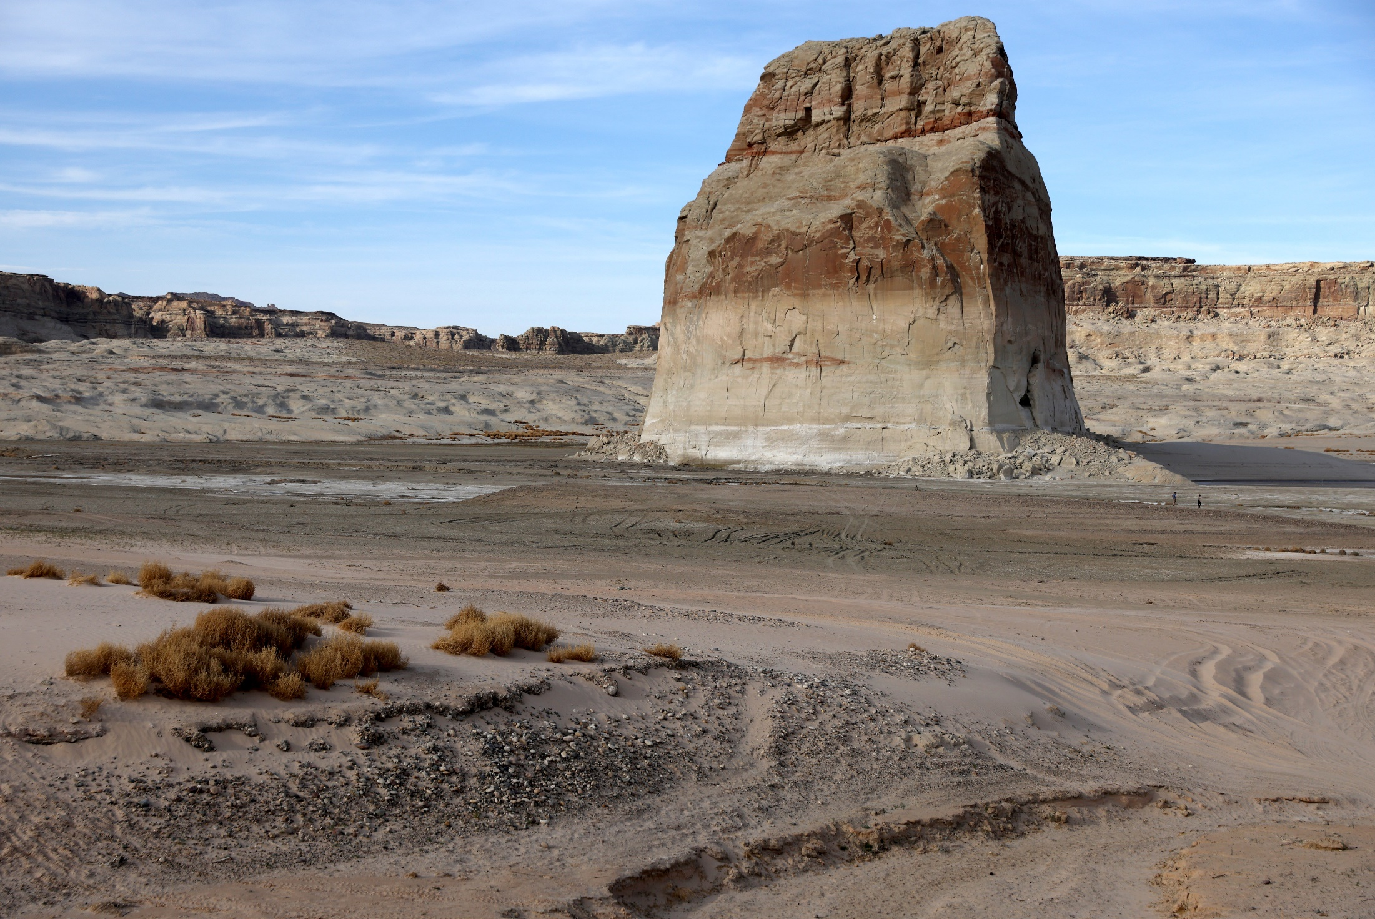
A rock in a desert or dry water feature

Slide 11
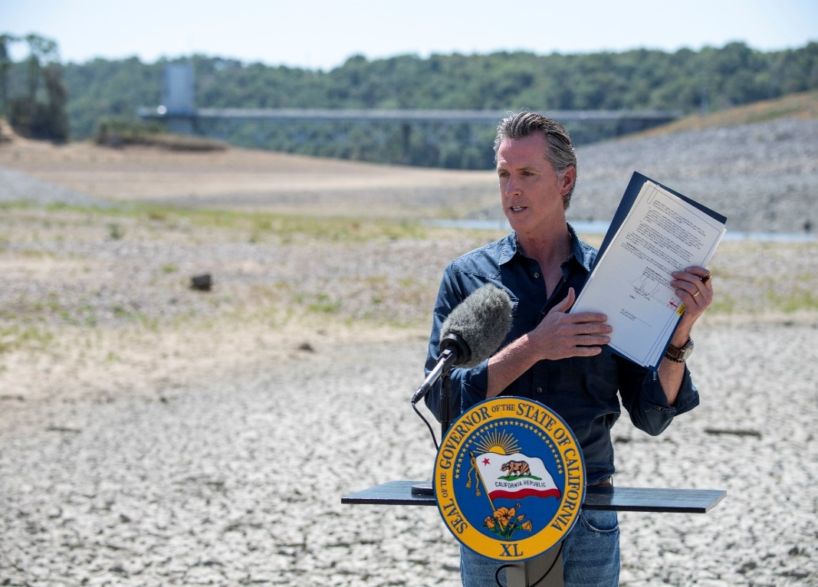
Where We Are Now
• State drought emergency proclamations issued in April, May, July, & Oct 2021, March 2022
• All 58 counties covered by state proclamations
• All counties covered by USDA drought disaster designations

Slide 12
Current State Response Actions for Drought Emergency
Operations of State Water Project under emergency authorities, installation of temporary emergency salinity barrier in Delta
SWRCB water rights curtailments
Financial assistance programs enacted in state budget last fiscal year and current fiscal year, for drought & longer-term water resilience, includes:
  DWR grants for small community urgent drought relief and for larger urban water agencies, free leak detection for small systems
  SWRCB revolving fund program funding for longer-term water/wastewater resilience
  Emergency drinking water assistance
  New this fiscal year, additional DWR grants for small agency/large agency water conservation projects and turf rebates
  Sustainable Groundwater Management Act grants to local groundwater agencies
  See drought.ca.gov for details

Slide 13
Cover of a report about drought

Slide 14
California’s 20th & 21st Century Statewide Droughts
(consecutive dry years)
1918-20
1922-24
1929-34
1947-50
1959-61
1976-77
1987-92
2007-09
2012-2016
2020- ??

Slide 15
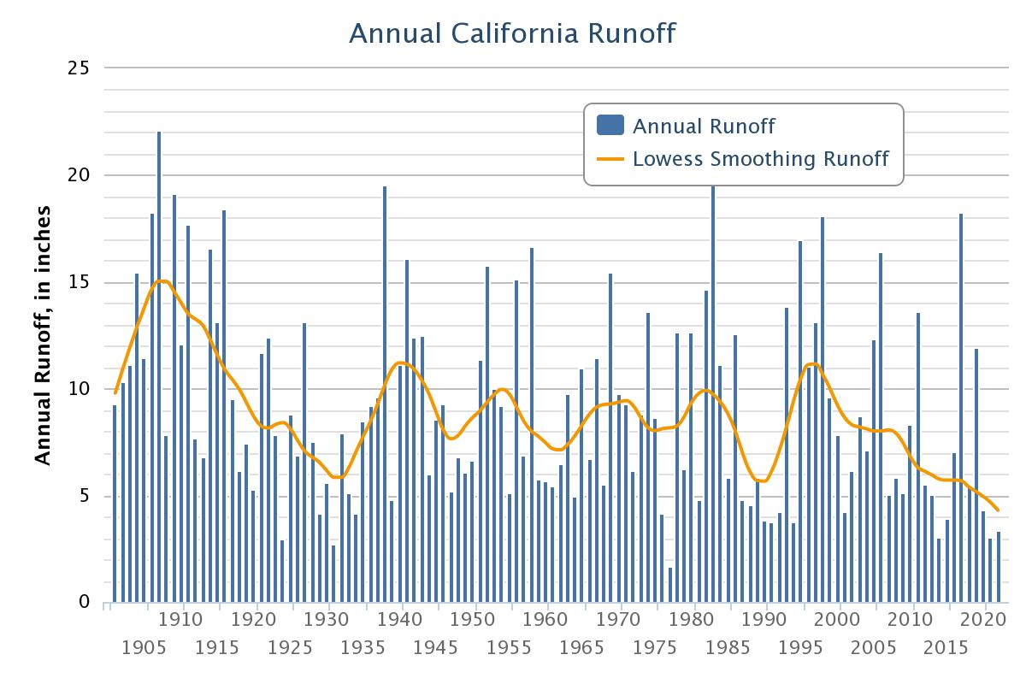
Annual California run off
Courtesy of University of Arizona

Slide 16
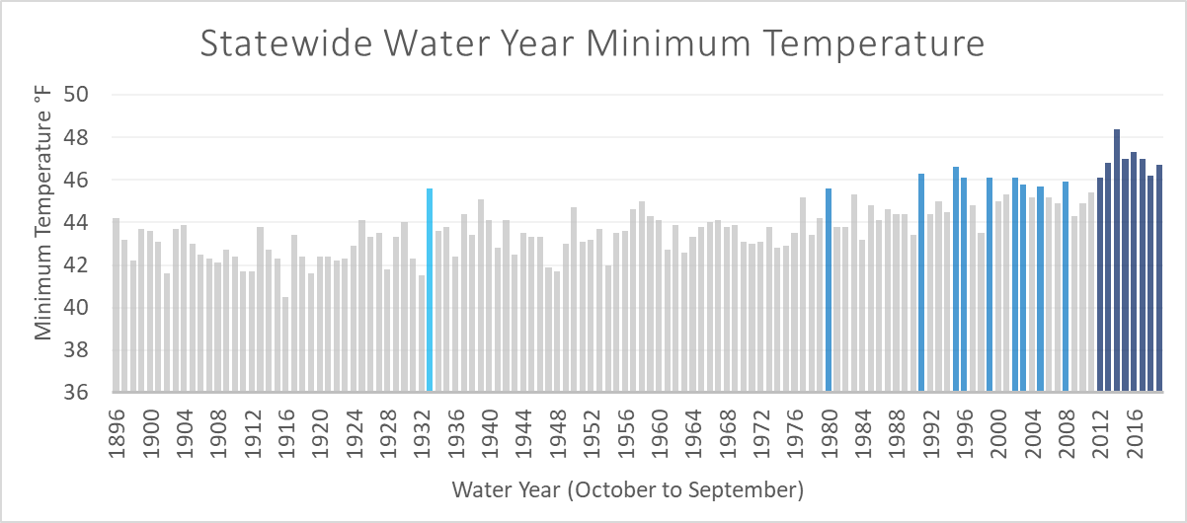
Things Are Changing in 21st Century

Slide 17
Expected Impacts of Multi-Year Drought
Unmanaged systems
  Risk of catastrophic wildfire (health & safety, economic)
  Non-irrigated agriculture (livestock grazing)
  Fish & wildlife (e.g., salmonids)
Managed systems
  Small water systems (health & safety)
  Irrigated agriculture
  Green industry (urban water supplies)
  Fish & wildlife (e.g., wildlife refuges, salmonids)
  Other environmental (e.g., land subsidence)

Slide 18
Lessons Learned From Past Droughts
Impacts are highly site-specific, and vary depending on the ability of water users to invest in reliability
Small water systems on fractured rock groundwater sources are most at risk of public health and safety impacts
Larger urban water agencies can manage 3-4 years of drought with minimal impacts to their customers
Cutbacks in historical irrigation deliveries can affect older shallow drinking water wells due to absence of groundwater recharge sources or compensatory construction of deeper irrigation wells

Slide 19
Things Are Changing
Old
New
Multi-year drought normal in reconstructed paleo & historical records
Severely reduced CVP & SWP allocations
Groundwater overdraft & land subsidence
Impacts in San Joaquin Valley
Droughts occur in warming climate, exacerbates impacts
First Lower Colorado River Basin shortage declared, SWP & CVP health & safety allocations
Early stages of SGMA implementation
Impacts in Sac Valley

Slide 20
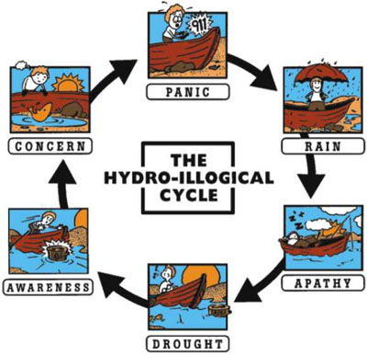
The (Old) Hydrological Cycle
University of Nebraska

Slide 21
Lessons Learned from Recent Droughts
Act sooner when dry conditions emerge
Recognize that increased temperatures are creating new or intensified impacts (e.g. wildfire)
Transition from thinking of drought as an occasional emergency to thinking in terms of creating resiliency in a more arid climate

Slide 22
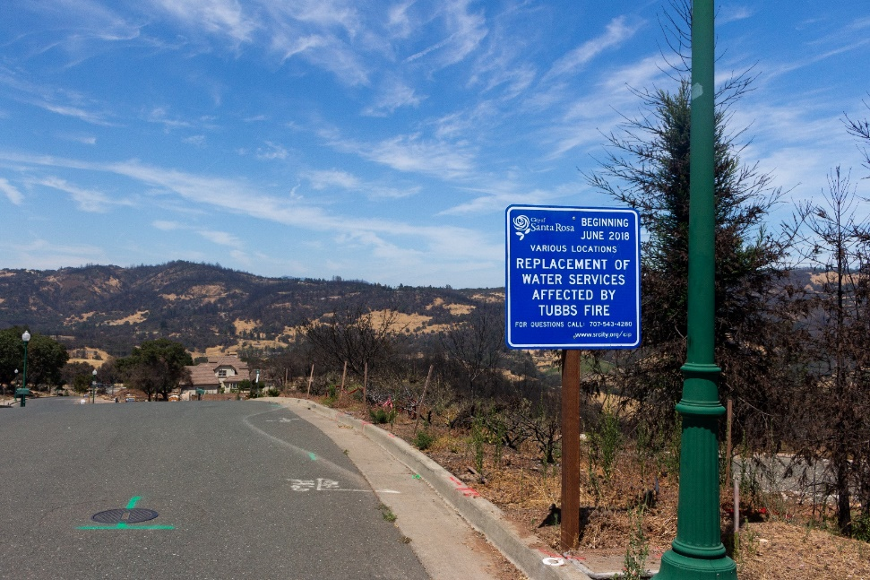
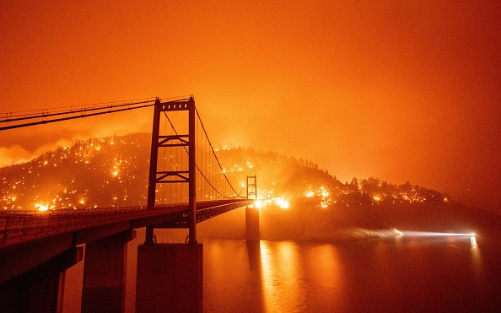
Catastrophic Wildfire Risk
All but 2 of the state’s 20 largest & 20 most damaging fires have occurred from 2000 onward
Destruction of urban water distribution systems: 2017 Tubbs Fire, 2018 Camp Fire, 2021 Dixie Fire
Risks/damage to large hydro plants

Slide 23
A Warmer/Dryer Climate
Three 21st century droughts: 2007-09, 2012-16, 2020-??
California is transitioning to a warmer & drier climate
August 2022 water supply strategy for adapting to a hotter, drier future

Slide 24
September 2022 Heatwave
134 Death Valley
125 Needles
124 Blythe
123 Palm Springs
121 Chico, Red Bluff
120 El Centro, Lake Cachuma, Lake Henshaw, Whiskeytown
119 Ojai, Redding
118 Calistoga, Elsinore, Ontario, Palmdale, Riverside
117 Chico, Healdsburg, Paso Robles, San Luis Obispo, Ukiah
116 Fullerton, Gilroy, Merced, Oroville, Sacramento
115 Bakersfield, Escondido, Madera, Pasadena
114 Fairfield, Fresno
113 Los Angeles
111 Long Beach, San Diego
110 San Rafael, Santa Cruz

Slide 25
California water supply report

Slide 26
Water Year 2023 Prospects
No skill in NOAA seasonal precipitation outlooks
Third year of cool phase of ENSO, historically the cool ENSO phase is usually dry in Southern California
Hope for the best, but prepare for a 4th dry year

Slide 27
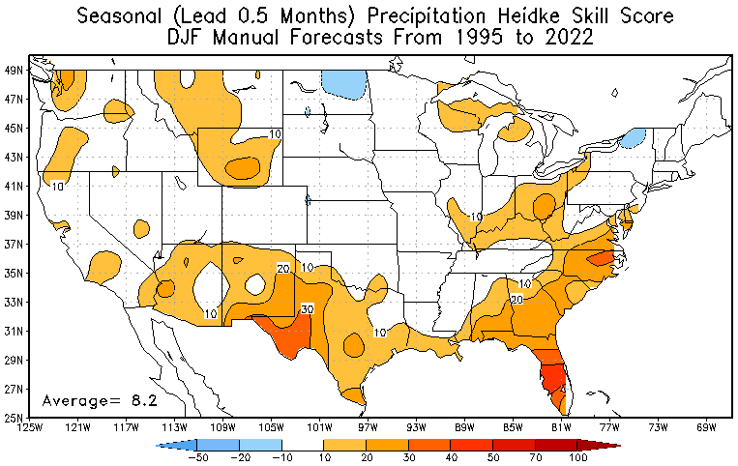
Historical Skill of NOAA Seasonal Outlooks – No Value for Water Management

Slide 28
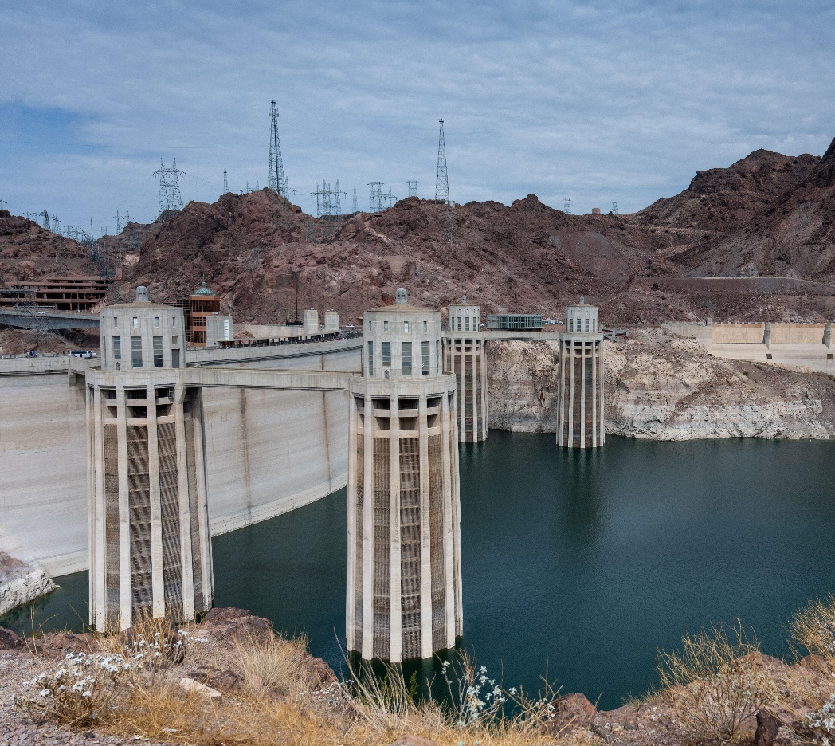
“I know it when I see it”
U.S. Supreme Court Justice Potter Stewart

